Slide 1

Operating Report Chicago 2017
Greg Rafferty

Slide 2

Divvy Bikes

Slide 3
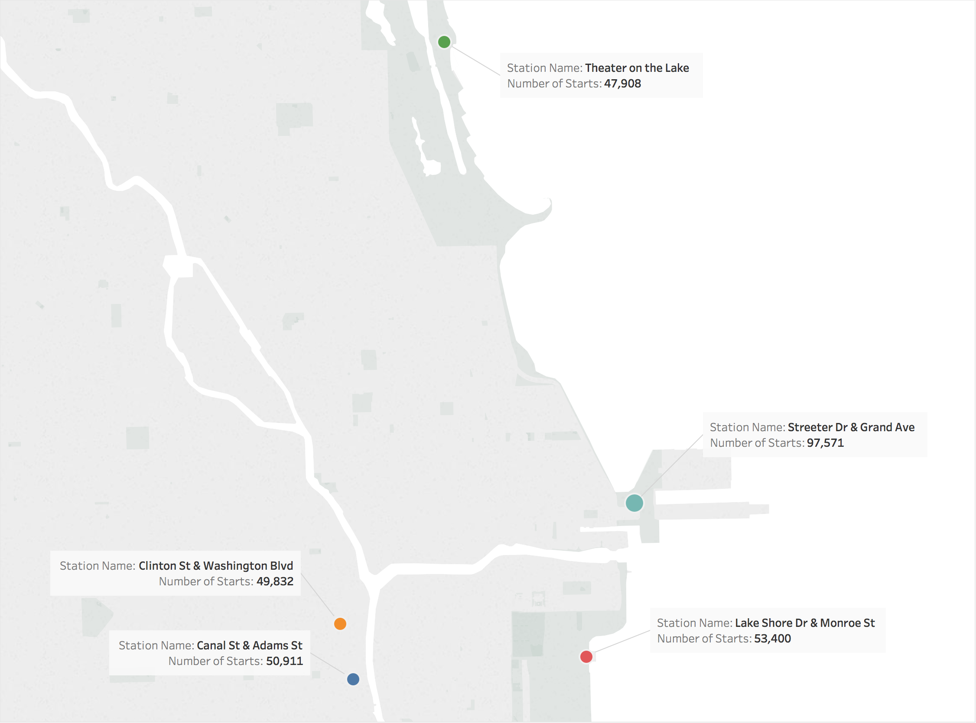
Top 5 Stations

Slide 4
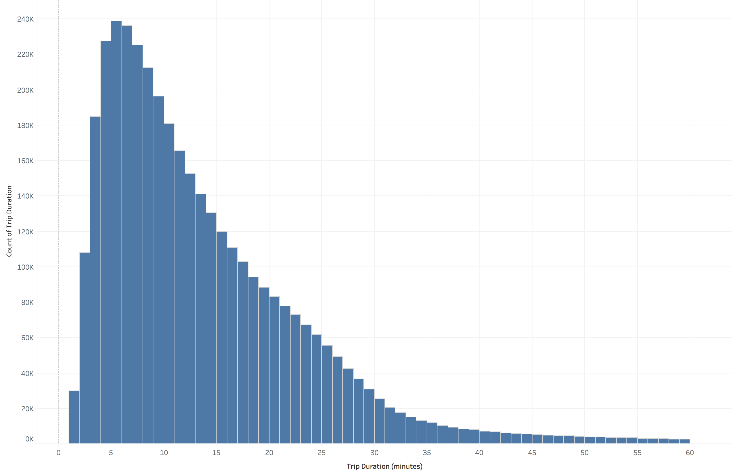
Trip Duration
Trip durations trail off dramatically after 60 minutes. There are several thousand outliers above this limit, some going up to 24 hours. I have excluded these outliers from further analysis.

Slide 5
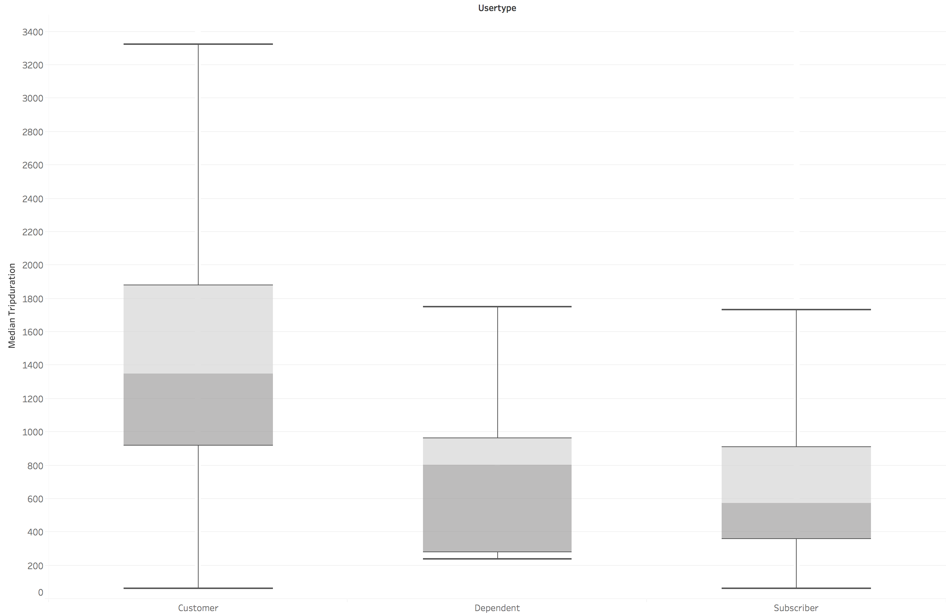
Trip Duration by user type
In a Box and Whisker chart, the box represents the middle 50% of the data, with the two shaded areas each composed of 25%. The whiskers extending above and below show the remaining 25% on either side. The line between the two shaded areas therefore shows the median value and the whiskers help explain the spread of the data.

Slide 6
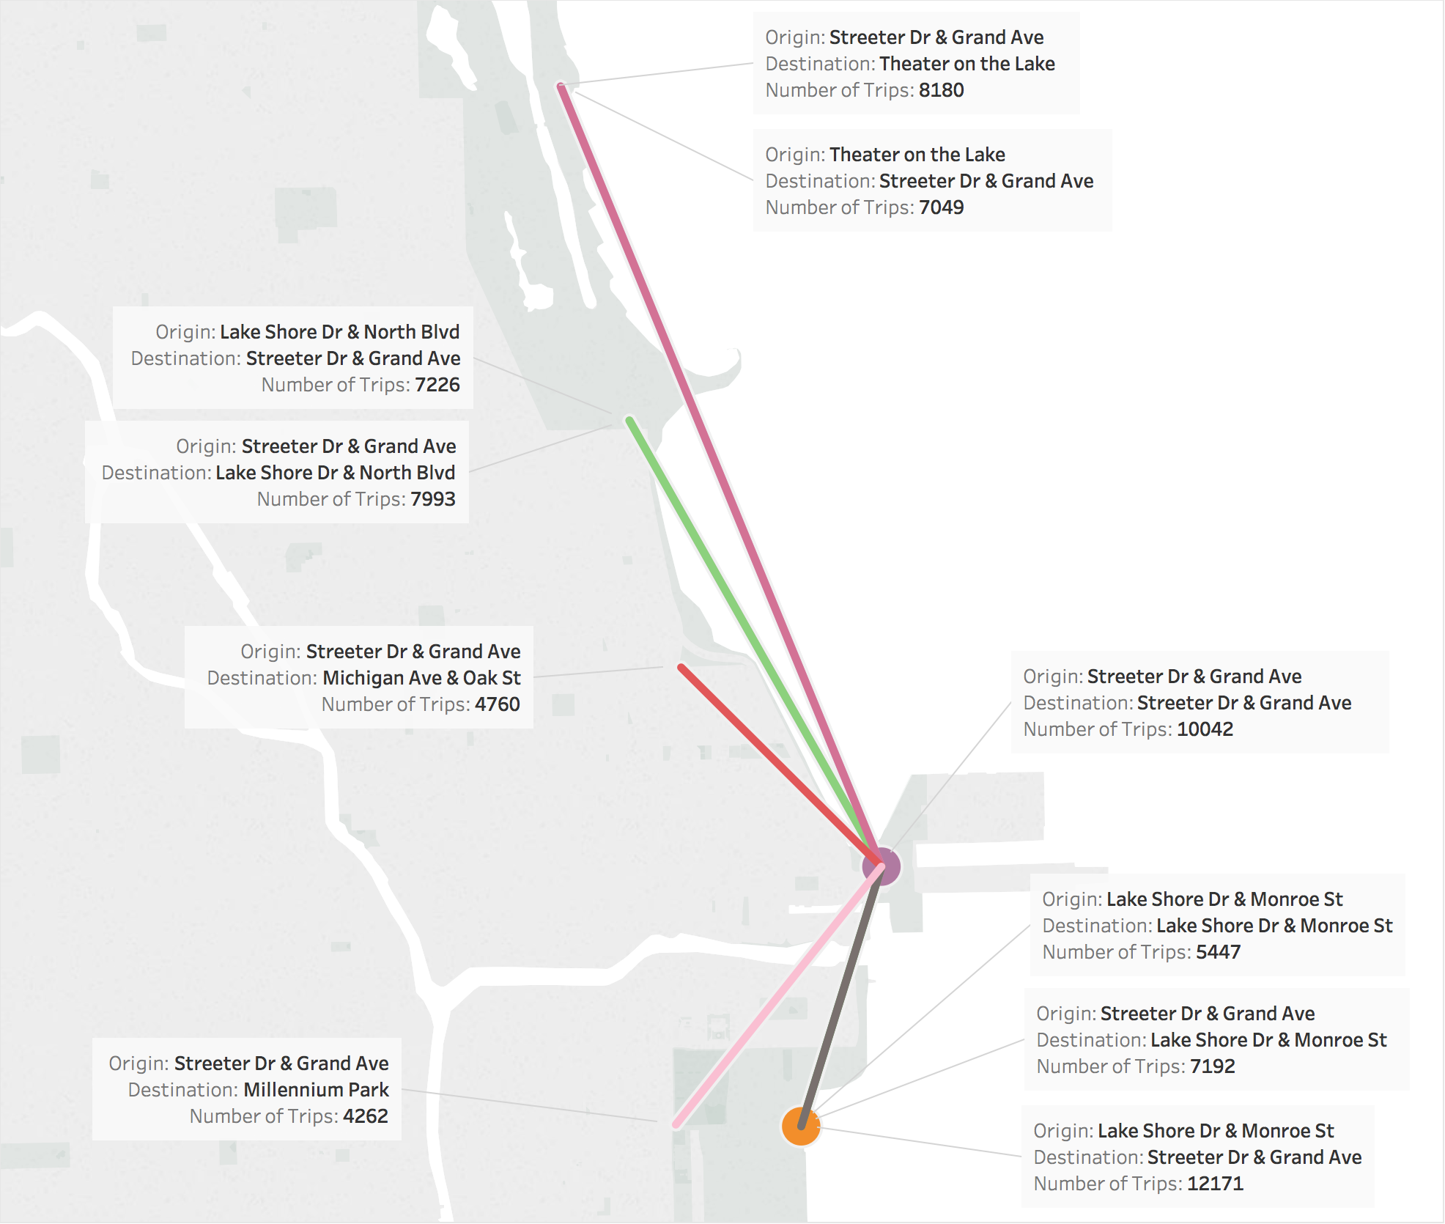
Most Popular Trips
Many of the most popular routes are doubled, ie Point A to Point B as well as Point B to Point A. Two (shown as a large circle) are circular routes (Point A back to Point A), possibly tourists exploring the city.

Slide 7
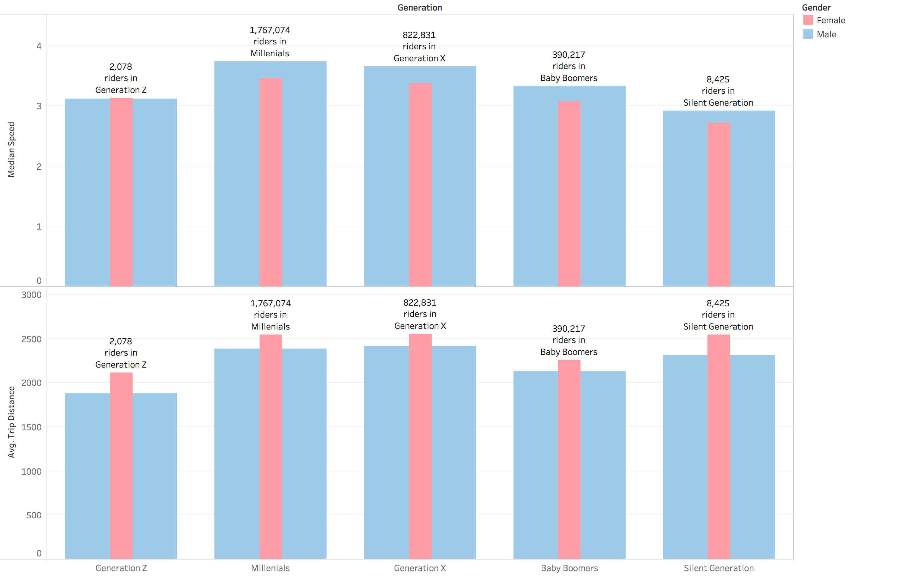
Rider Performance by gender
Interestingly, men tend to ride faster than women, but women tend to ride for longer distances.

Slide 8
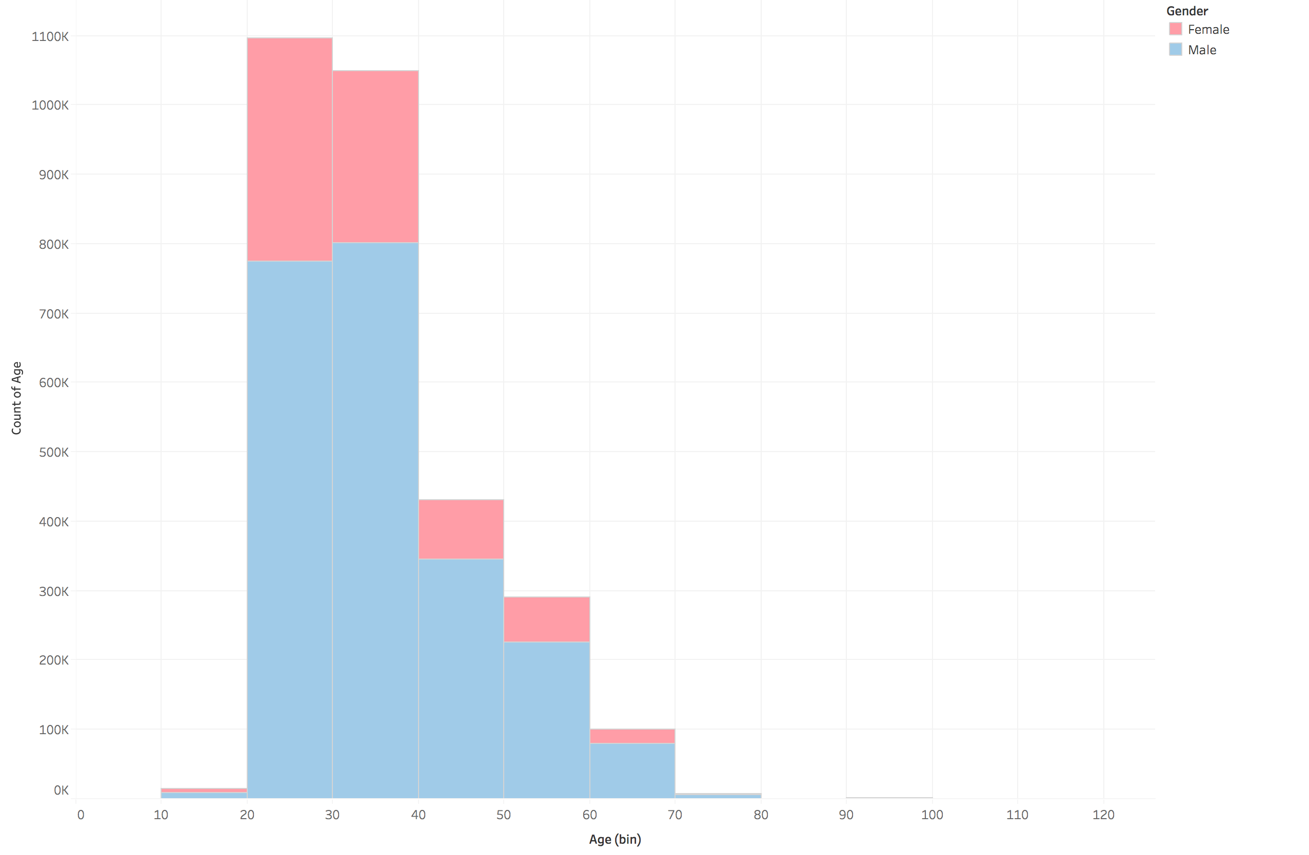
Rider Numbers by gender
The majority of riders are between ages 20 and 40, with men accounting for more of the share than women. Even though some ages in the dataset extend all the way up to 120, and many down to 0, I have only included ages between 10 and 80 in this analysis.

Slide 9
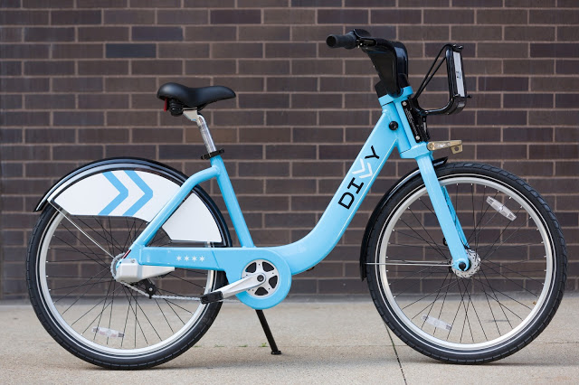
Busiest Bike
Bike ID 2565
Rides 1,489
Time Ridden 375 hours
Distance Traveled 2,175 miles
Average Speed 5.79 mph

Slide 10
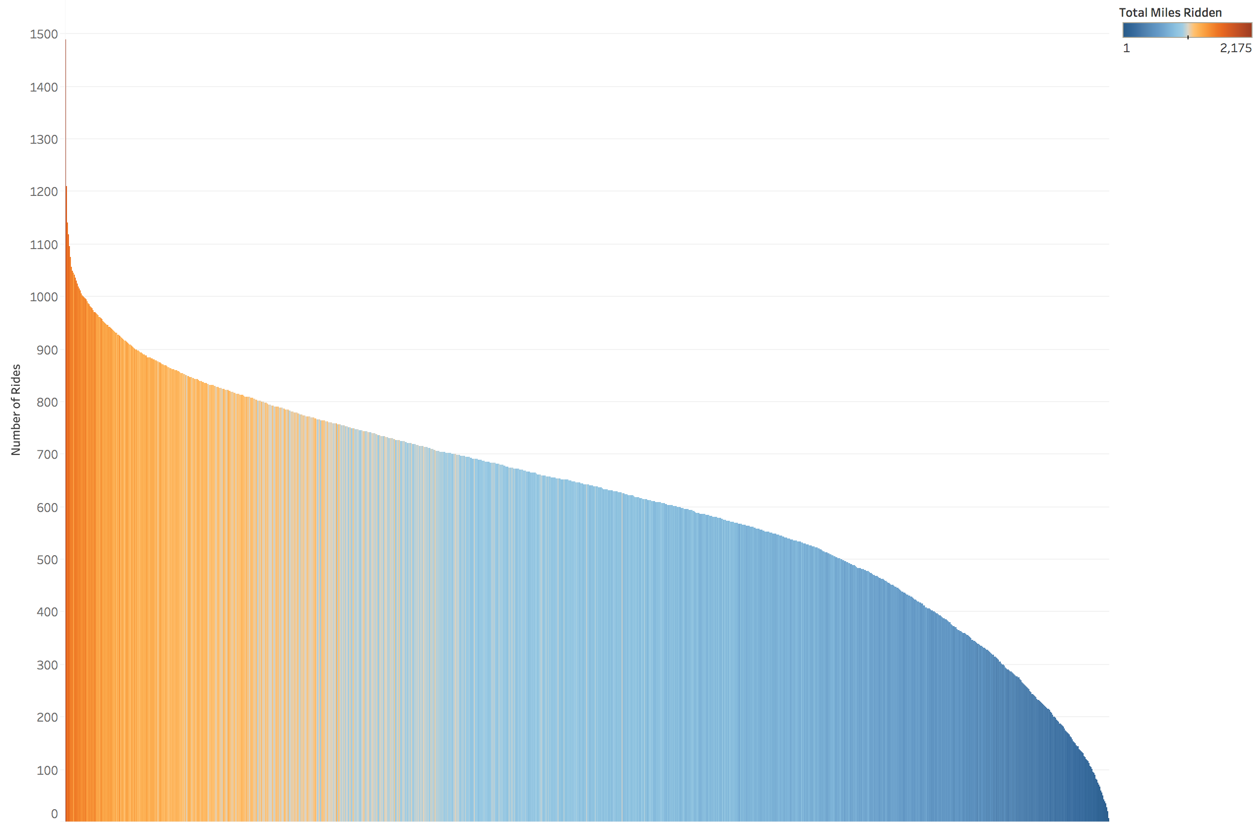
Rides per Bike
Each of the 6,243 bikes ridden in 2017 is shown by a single vertical line. The height of the line represents the number of rides taken on that bike and the color shows the total miles ridden.
Bike 2565, the busiest bike, is the line on the far left.
Possibly some bikes were introduced late in the year and not used as much, but it does appear that a better distribution could be attained by moving bikes around, thus spreading out maintenance evenly.

Slide 11

Yelp

Slide 12
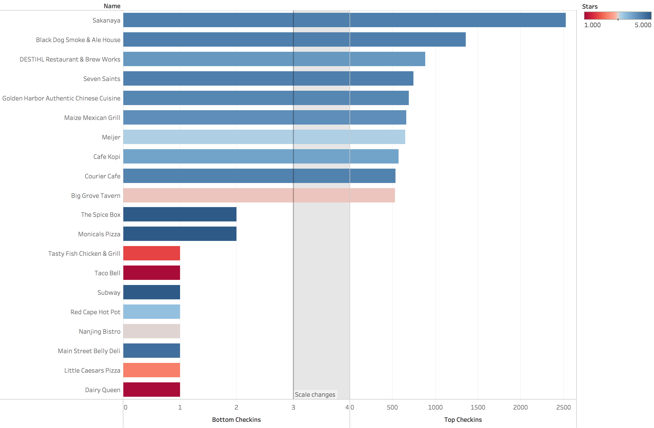
Top and Bottom 10 Restaurants
Note that the x-axis starts over and changes scale between the top 10 and bottom 10 restaurants. Restaurants with 0 check-ins have been excluded.

Slide 13
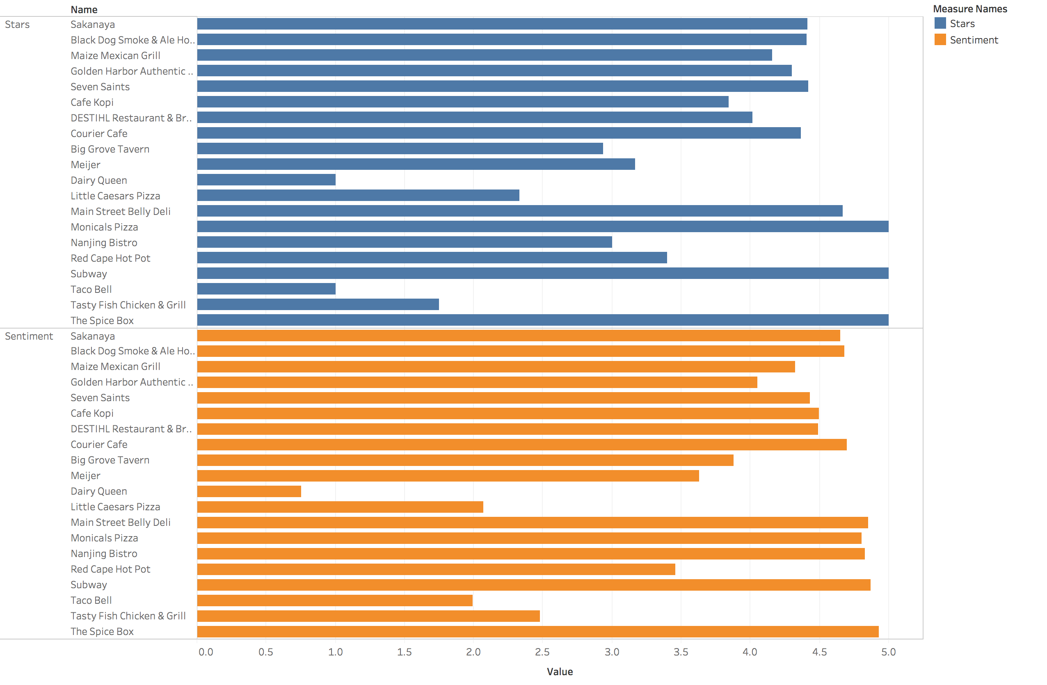
Stars and Sentiment
Sentiment is on a scale of 0 between extremely negative to 5 between extremely positive.

Slide 14
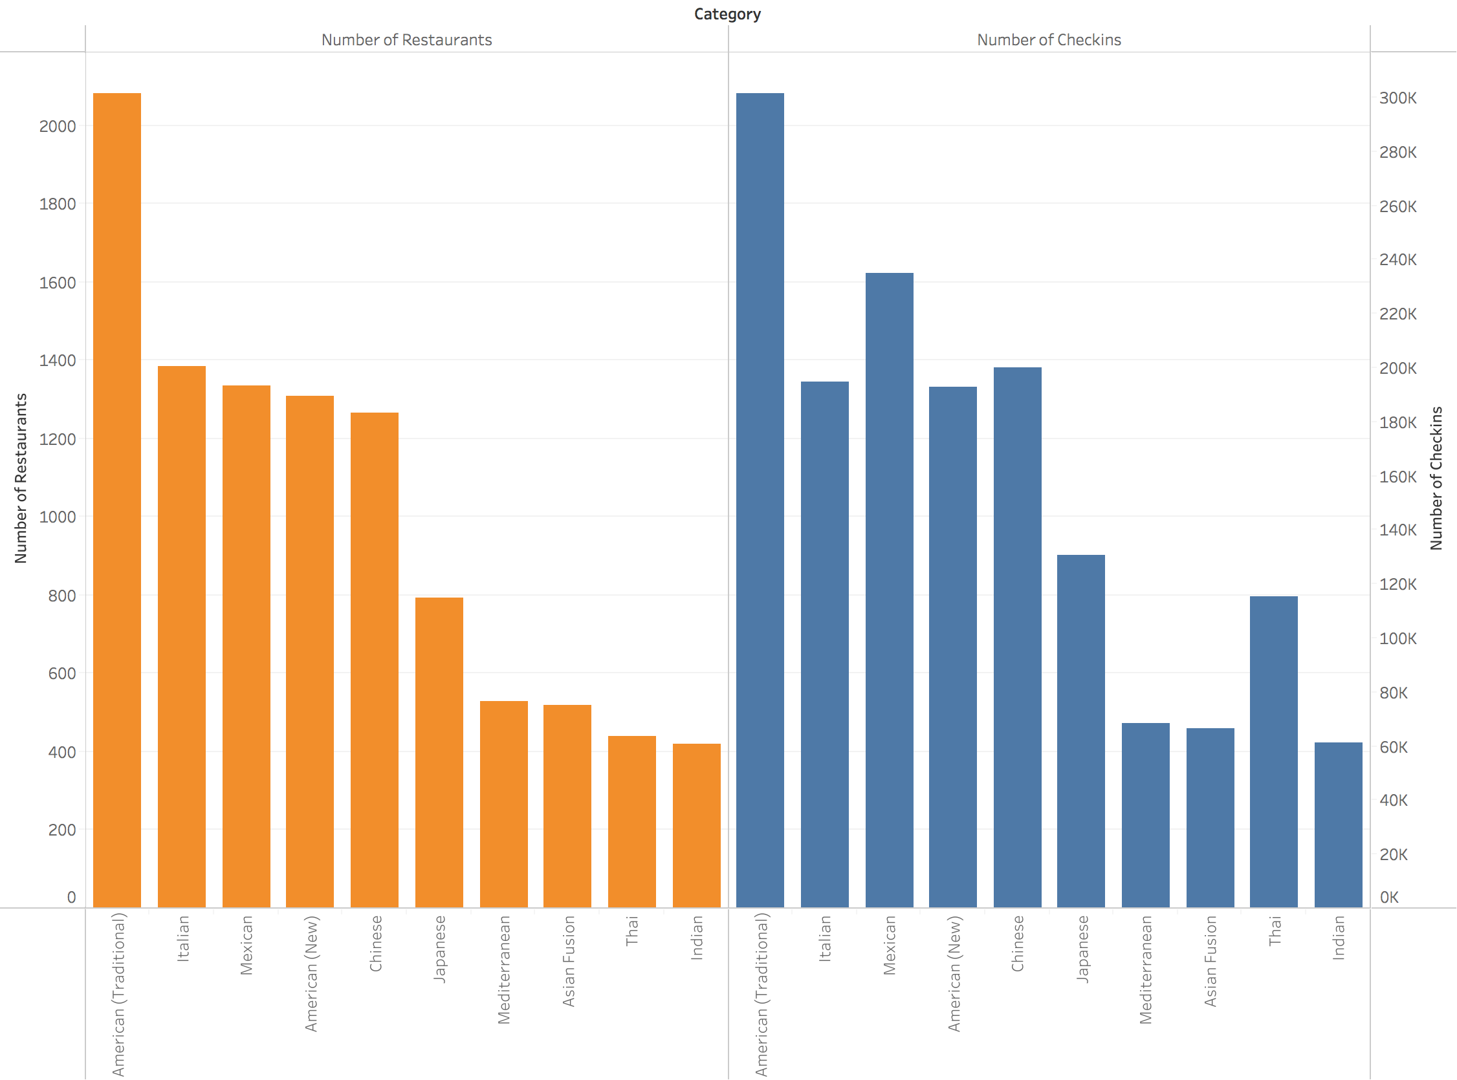
Top 10 Cuisine Types
The top 10 cuisine types by number of restaurants and by number of check-ins is the same, but the order is slightly different.

Slide 15
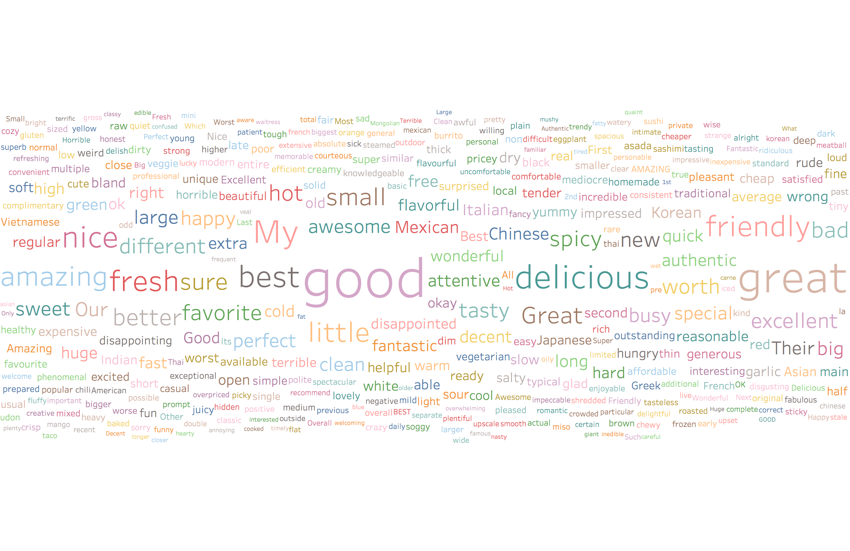
Word Cloud all cuisine types

Slide 16
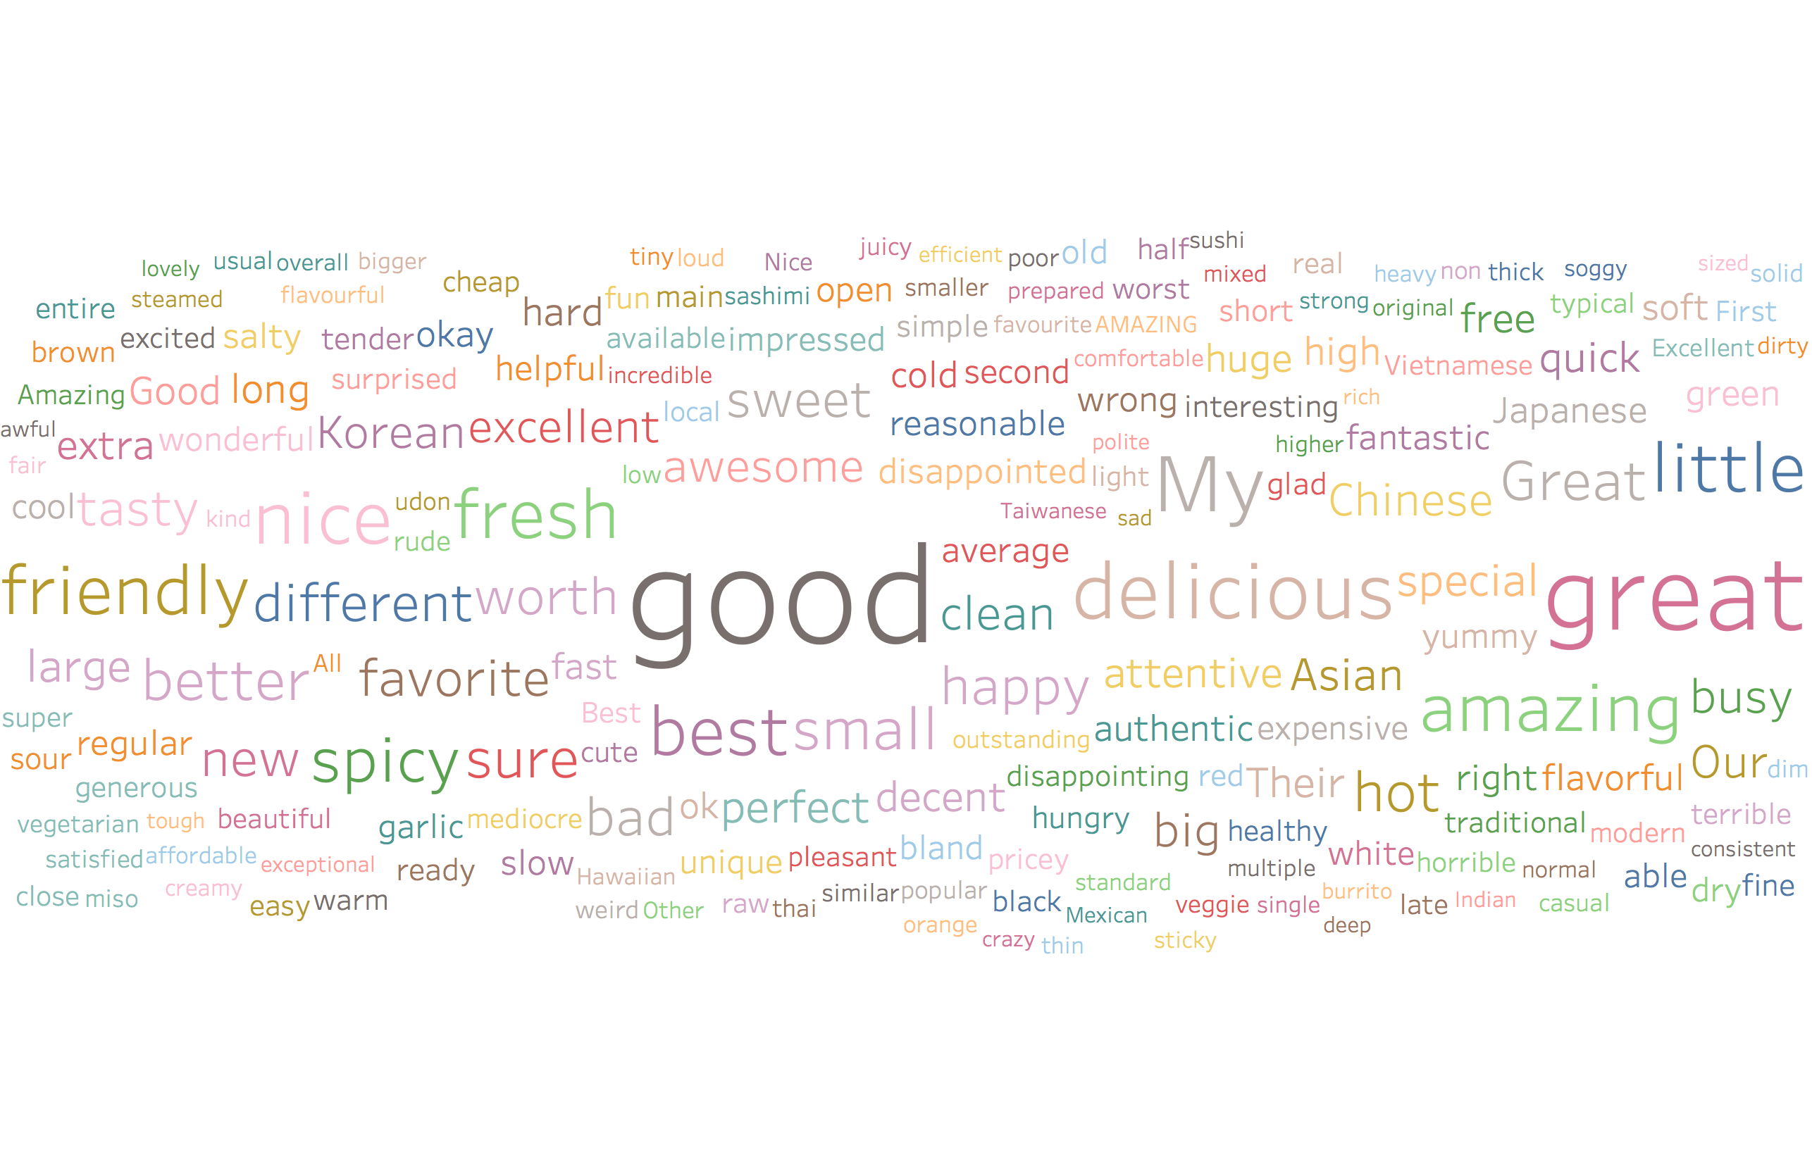
Word Cloud Asian Fusion

Slide 17
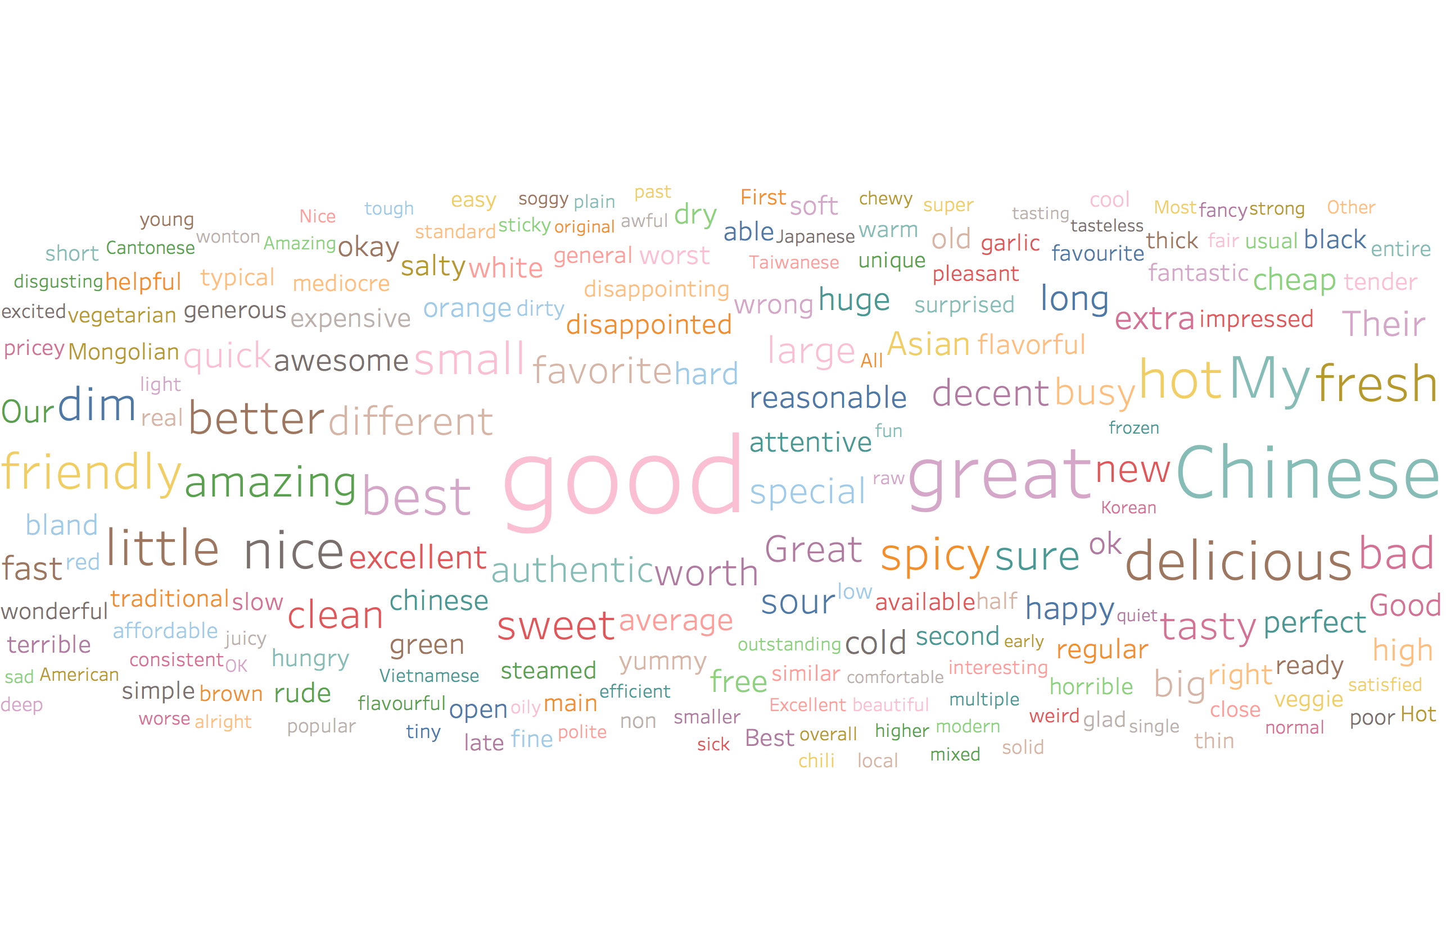
Word Cloud Chinese

Slide 18
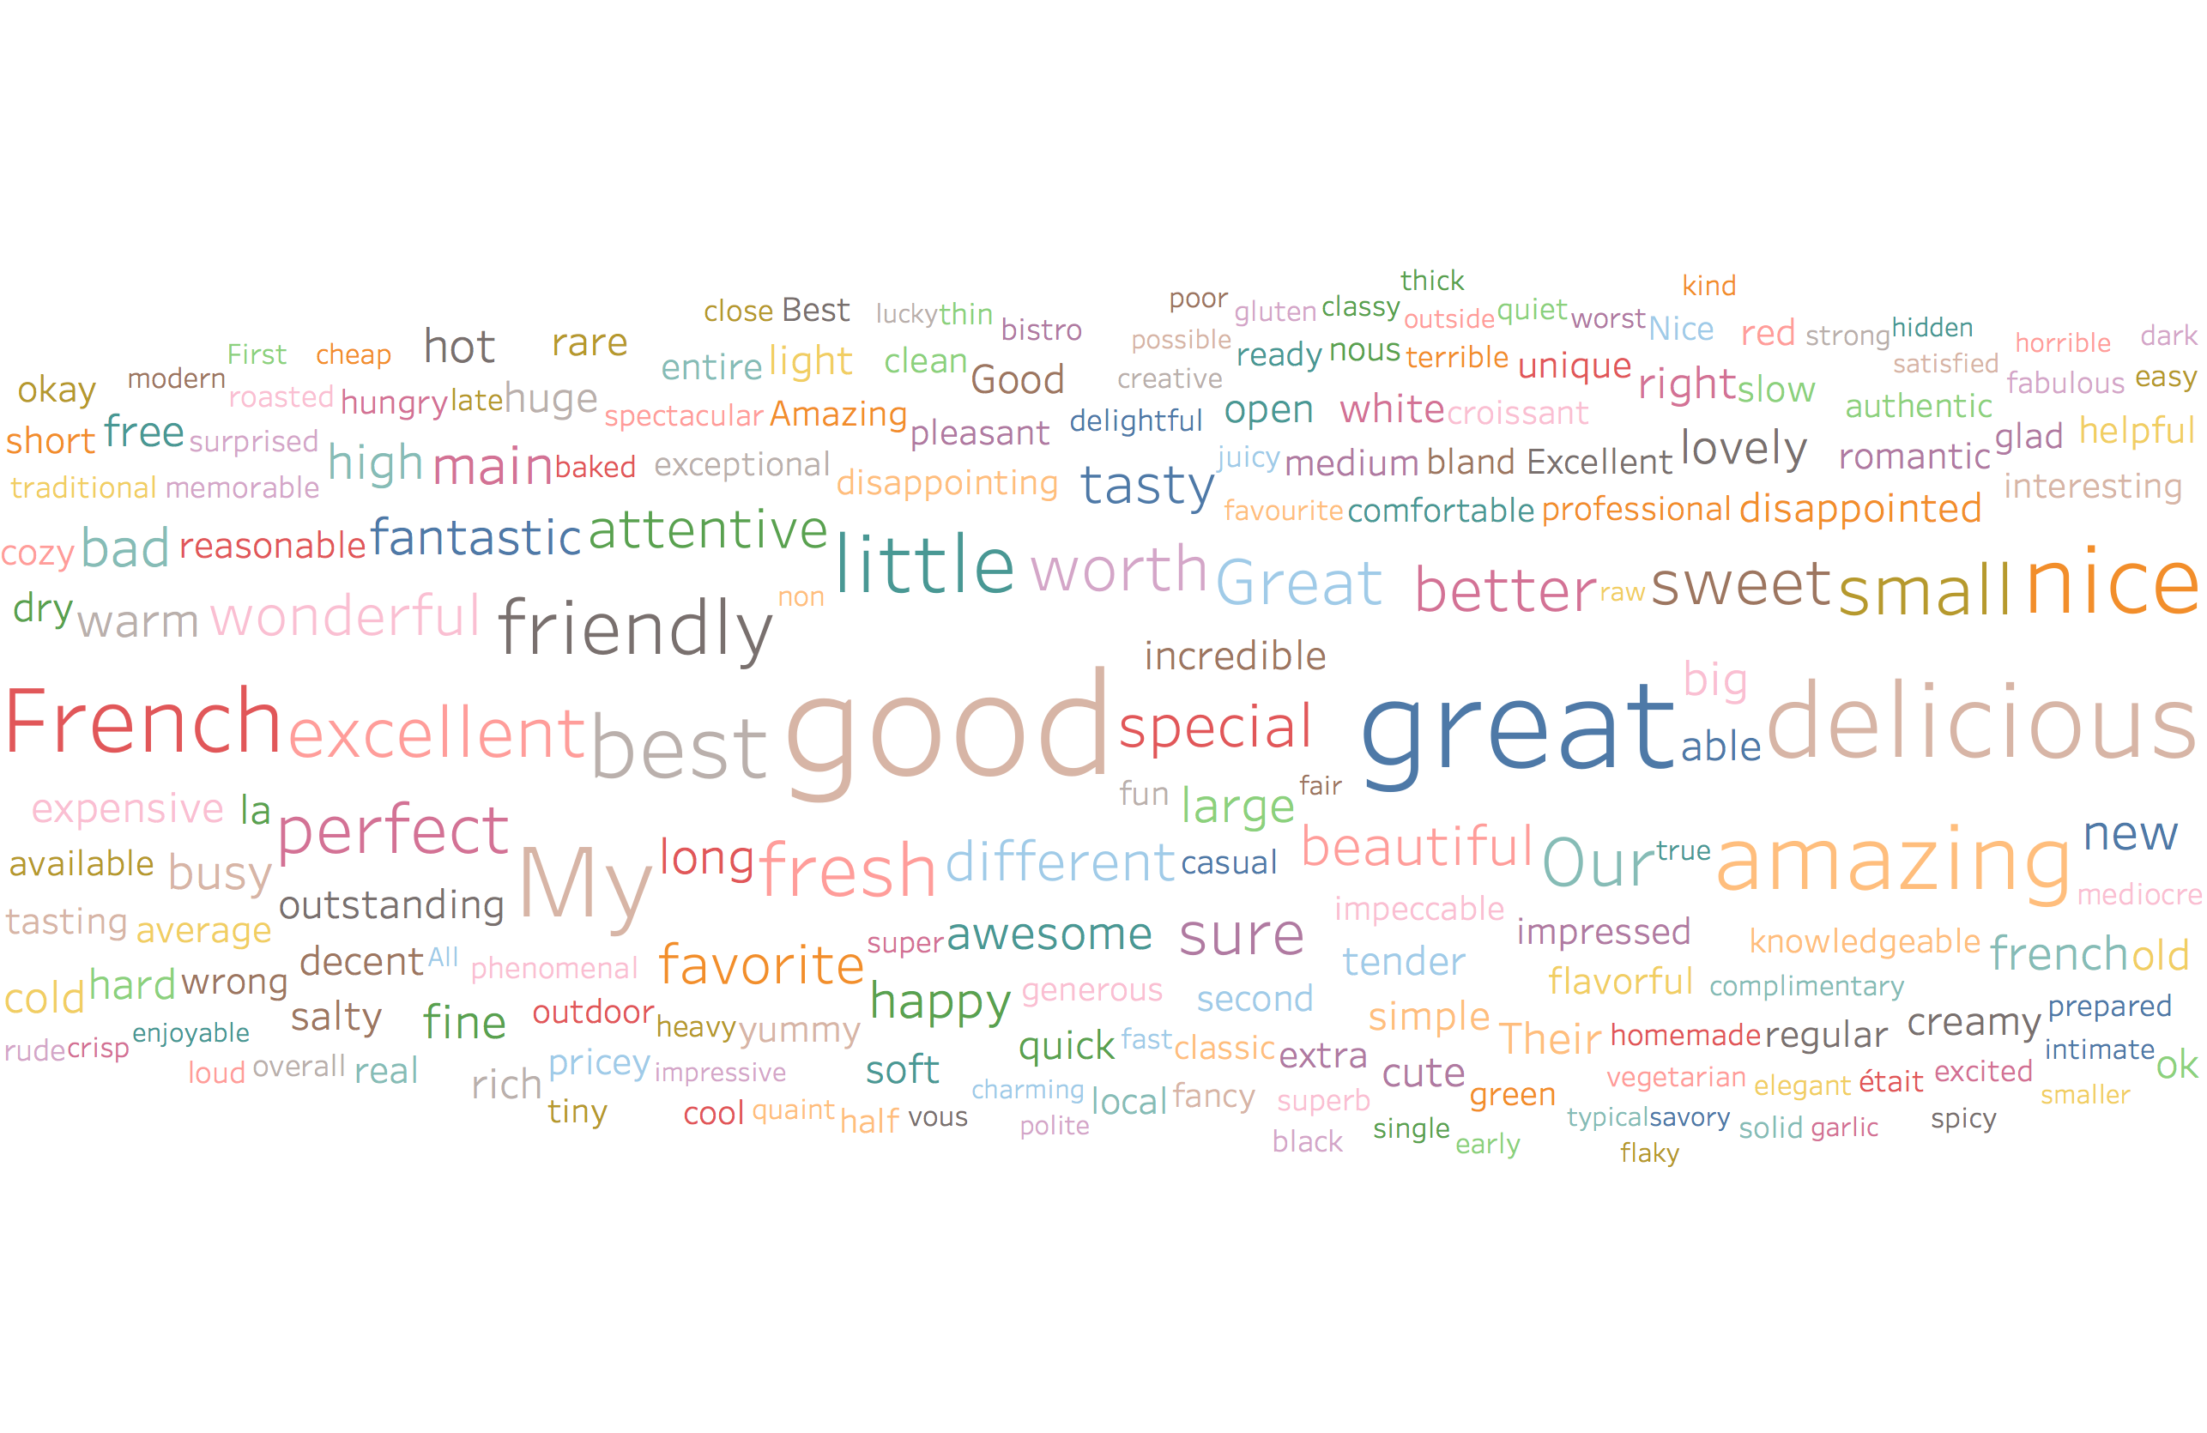
Word Cloud French

Slide 19
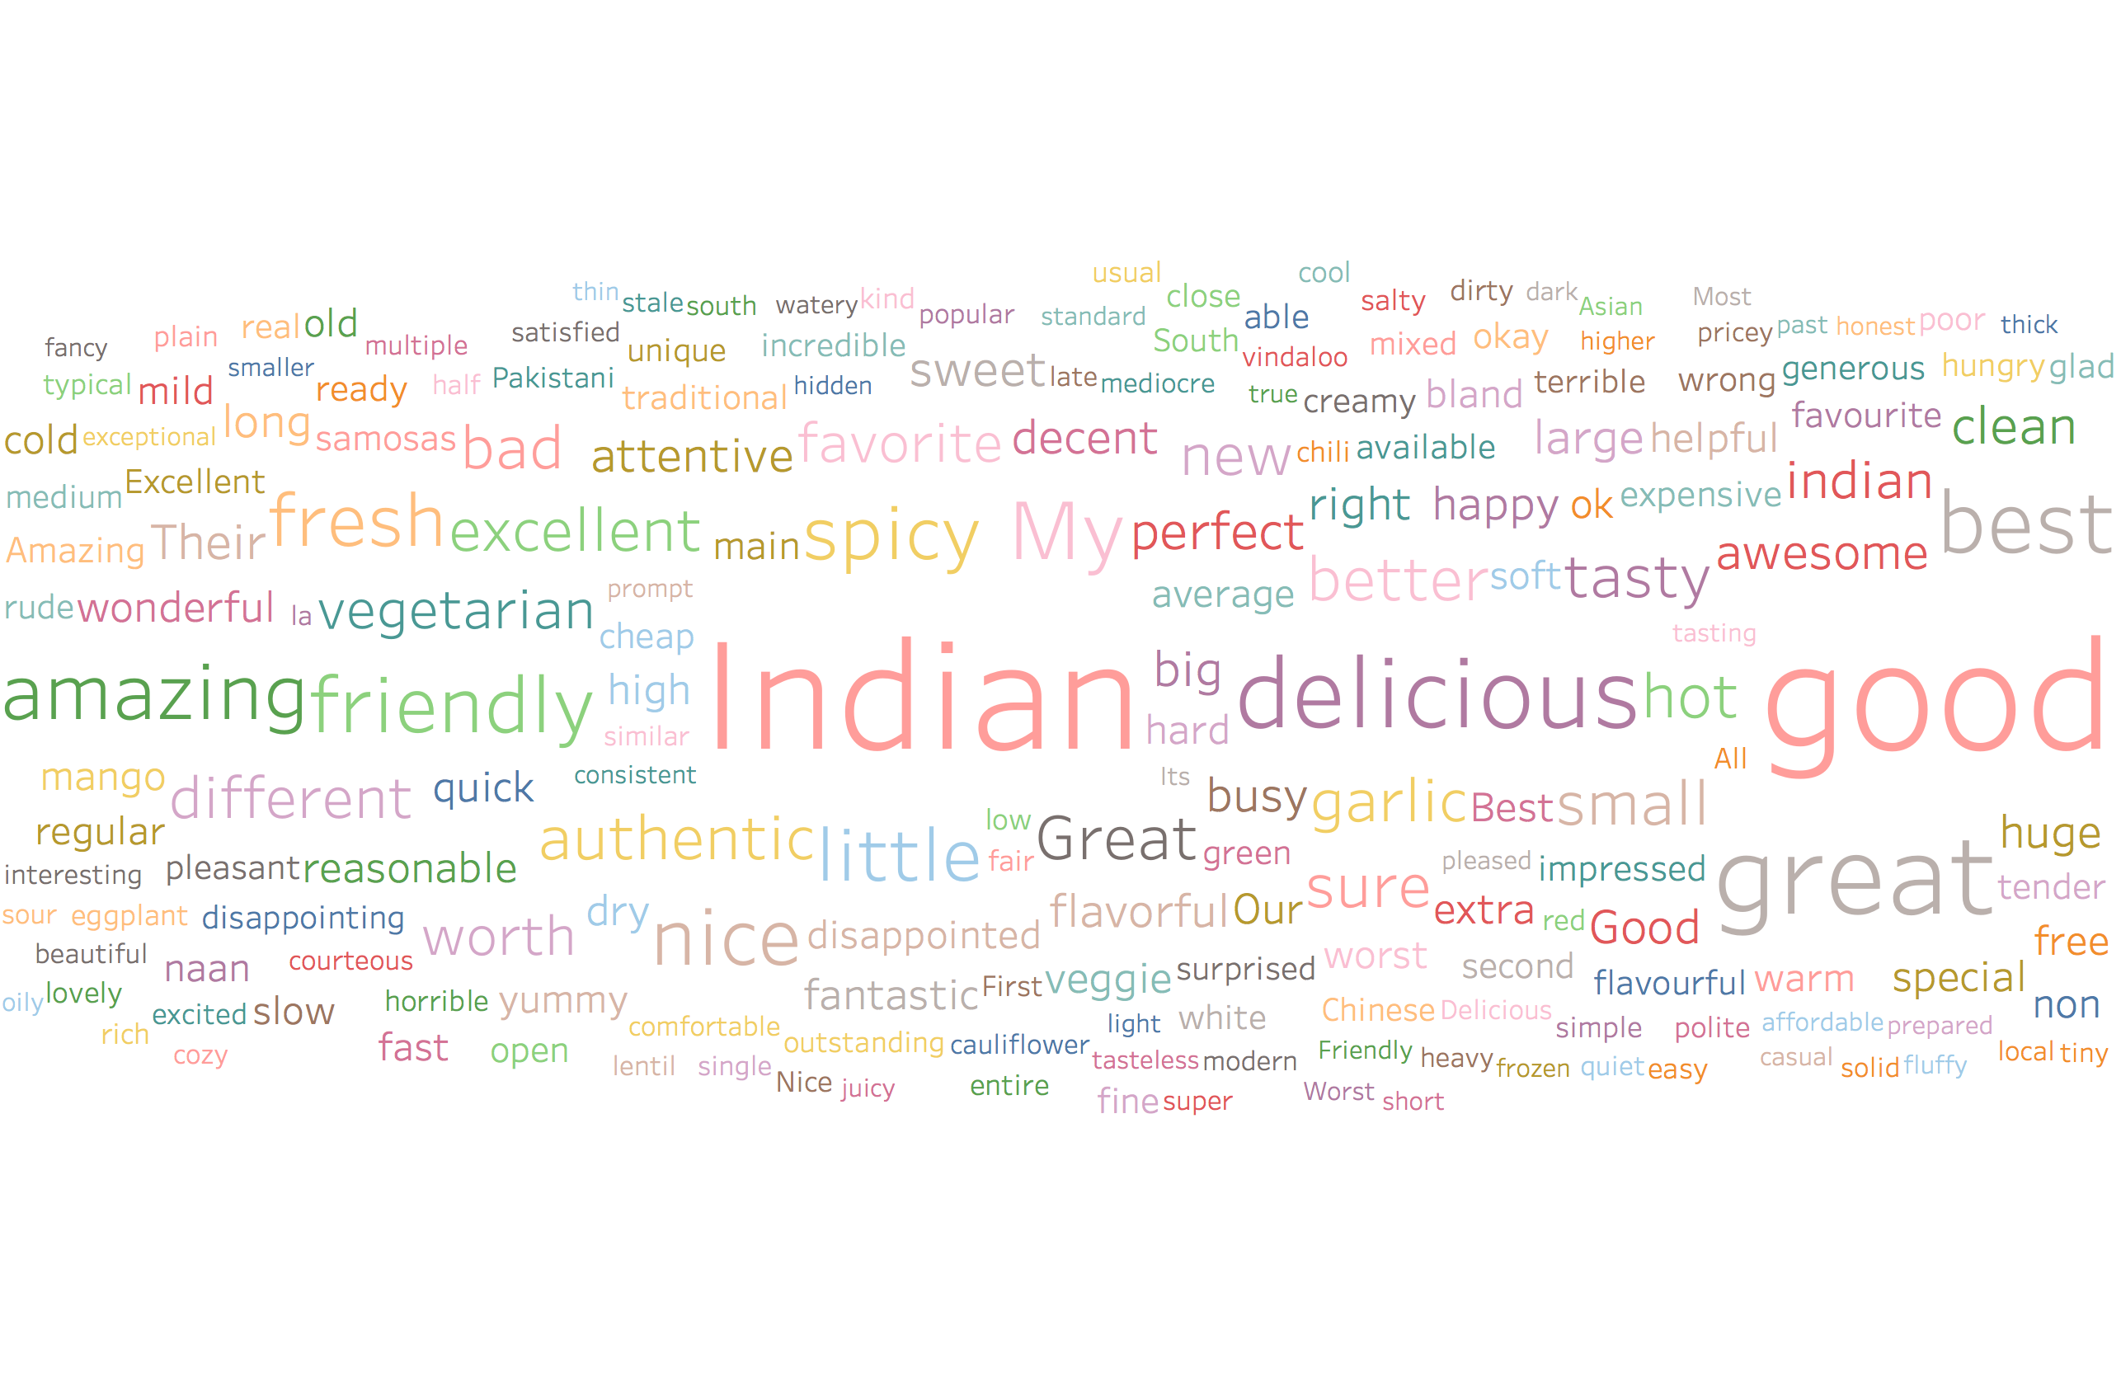
Word Cloud Indian

Slide 20
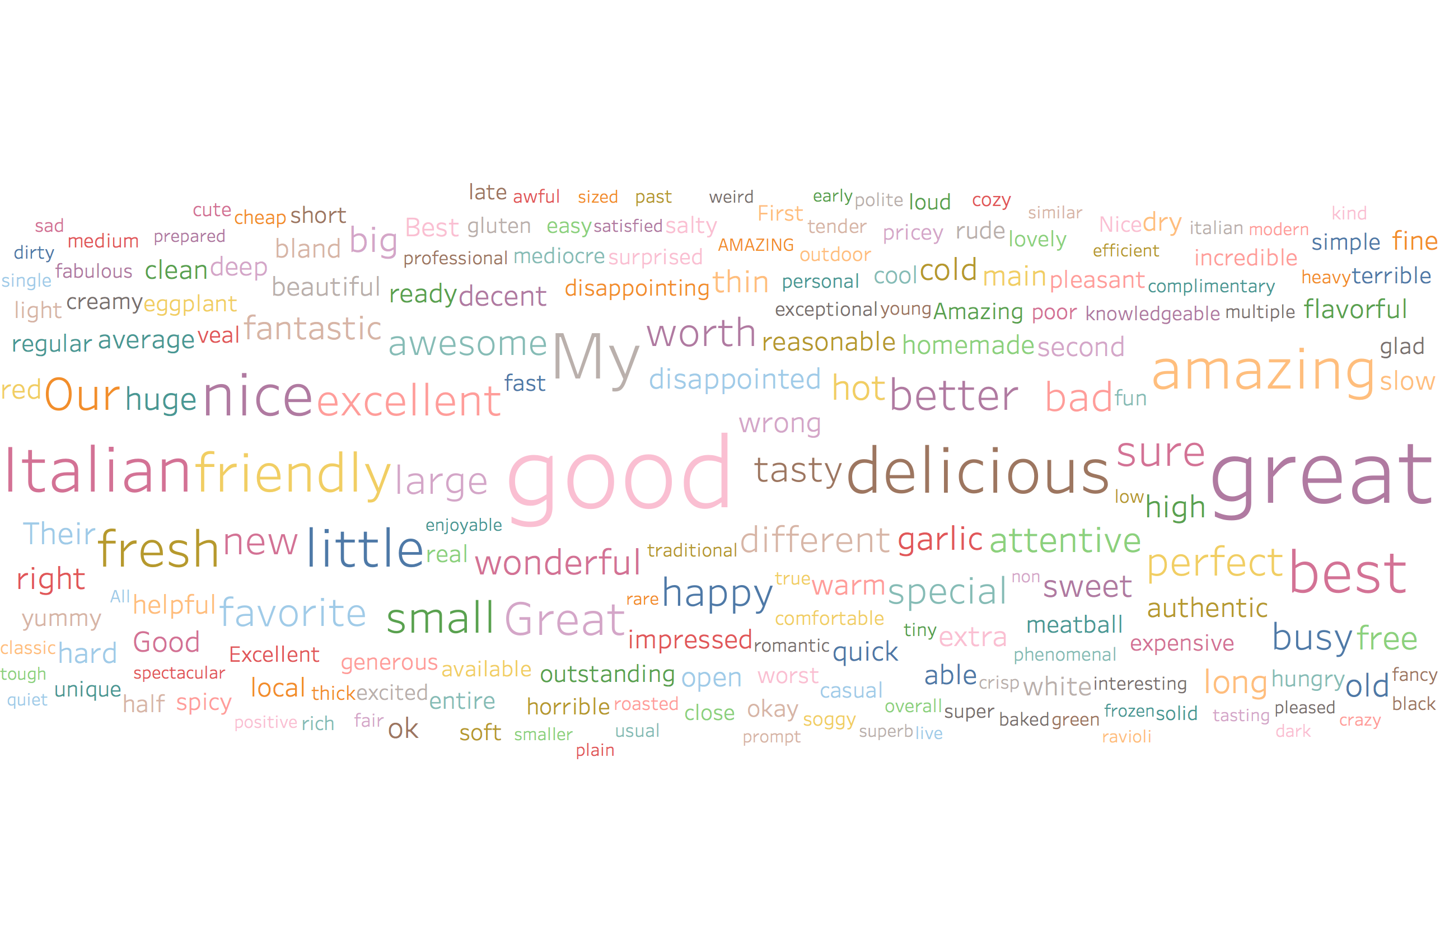
Word Cloud Italian

Slide 21
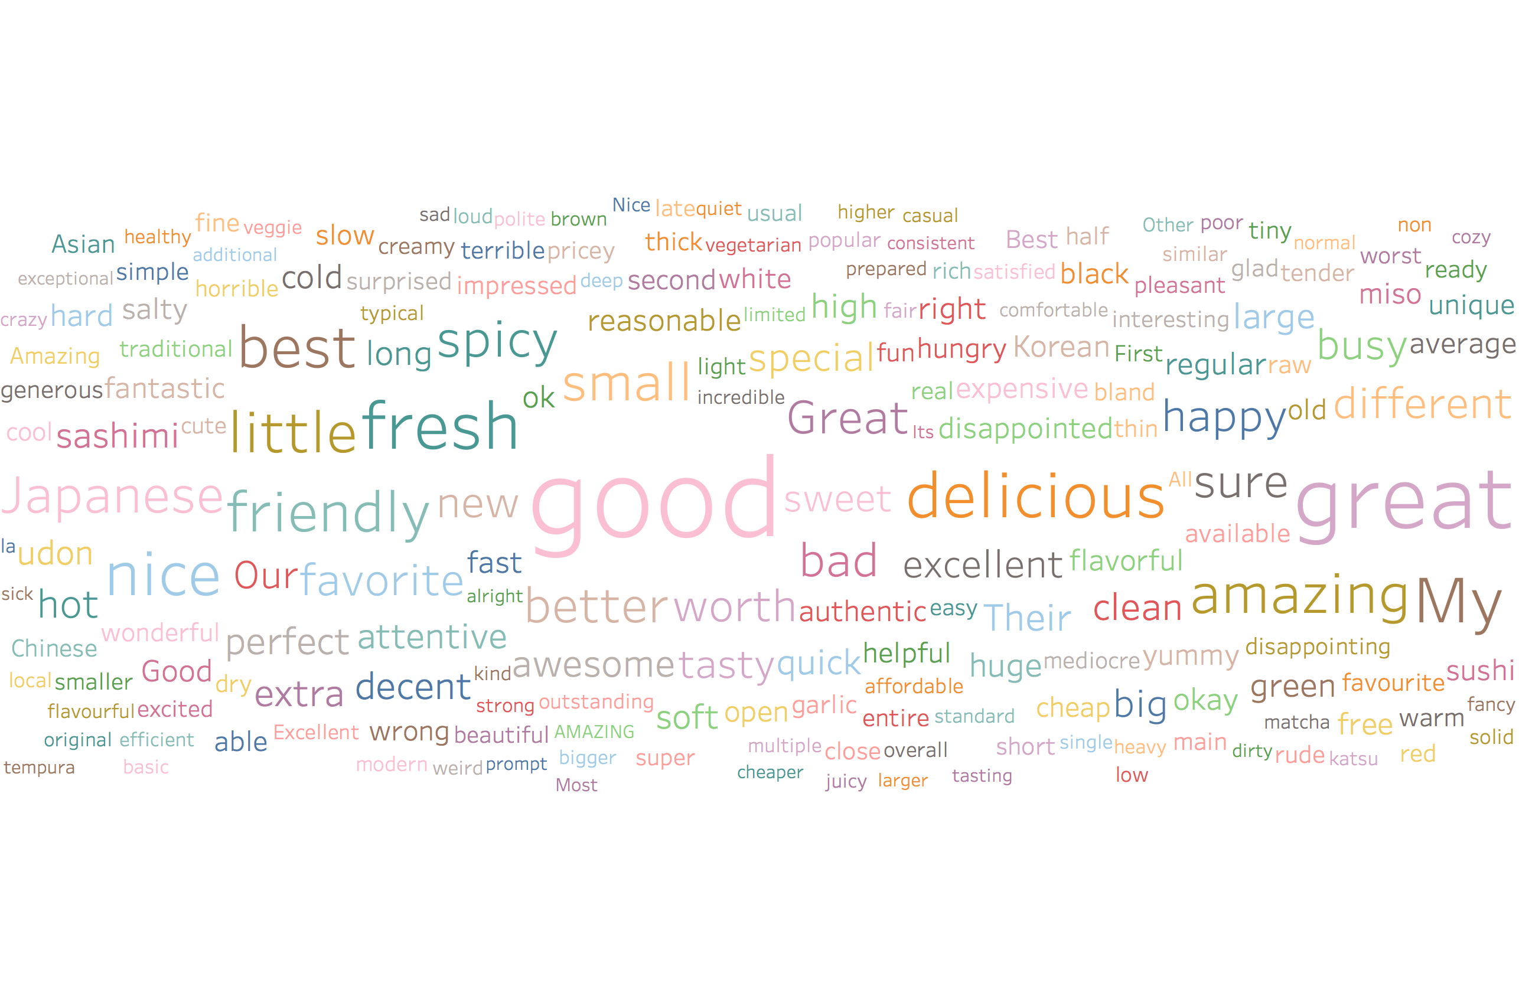
Word Cloud Japanese

Slide 22
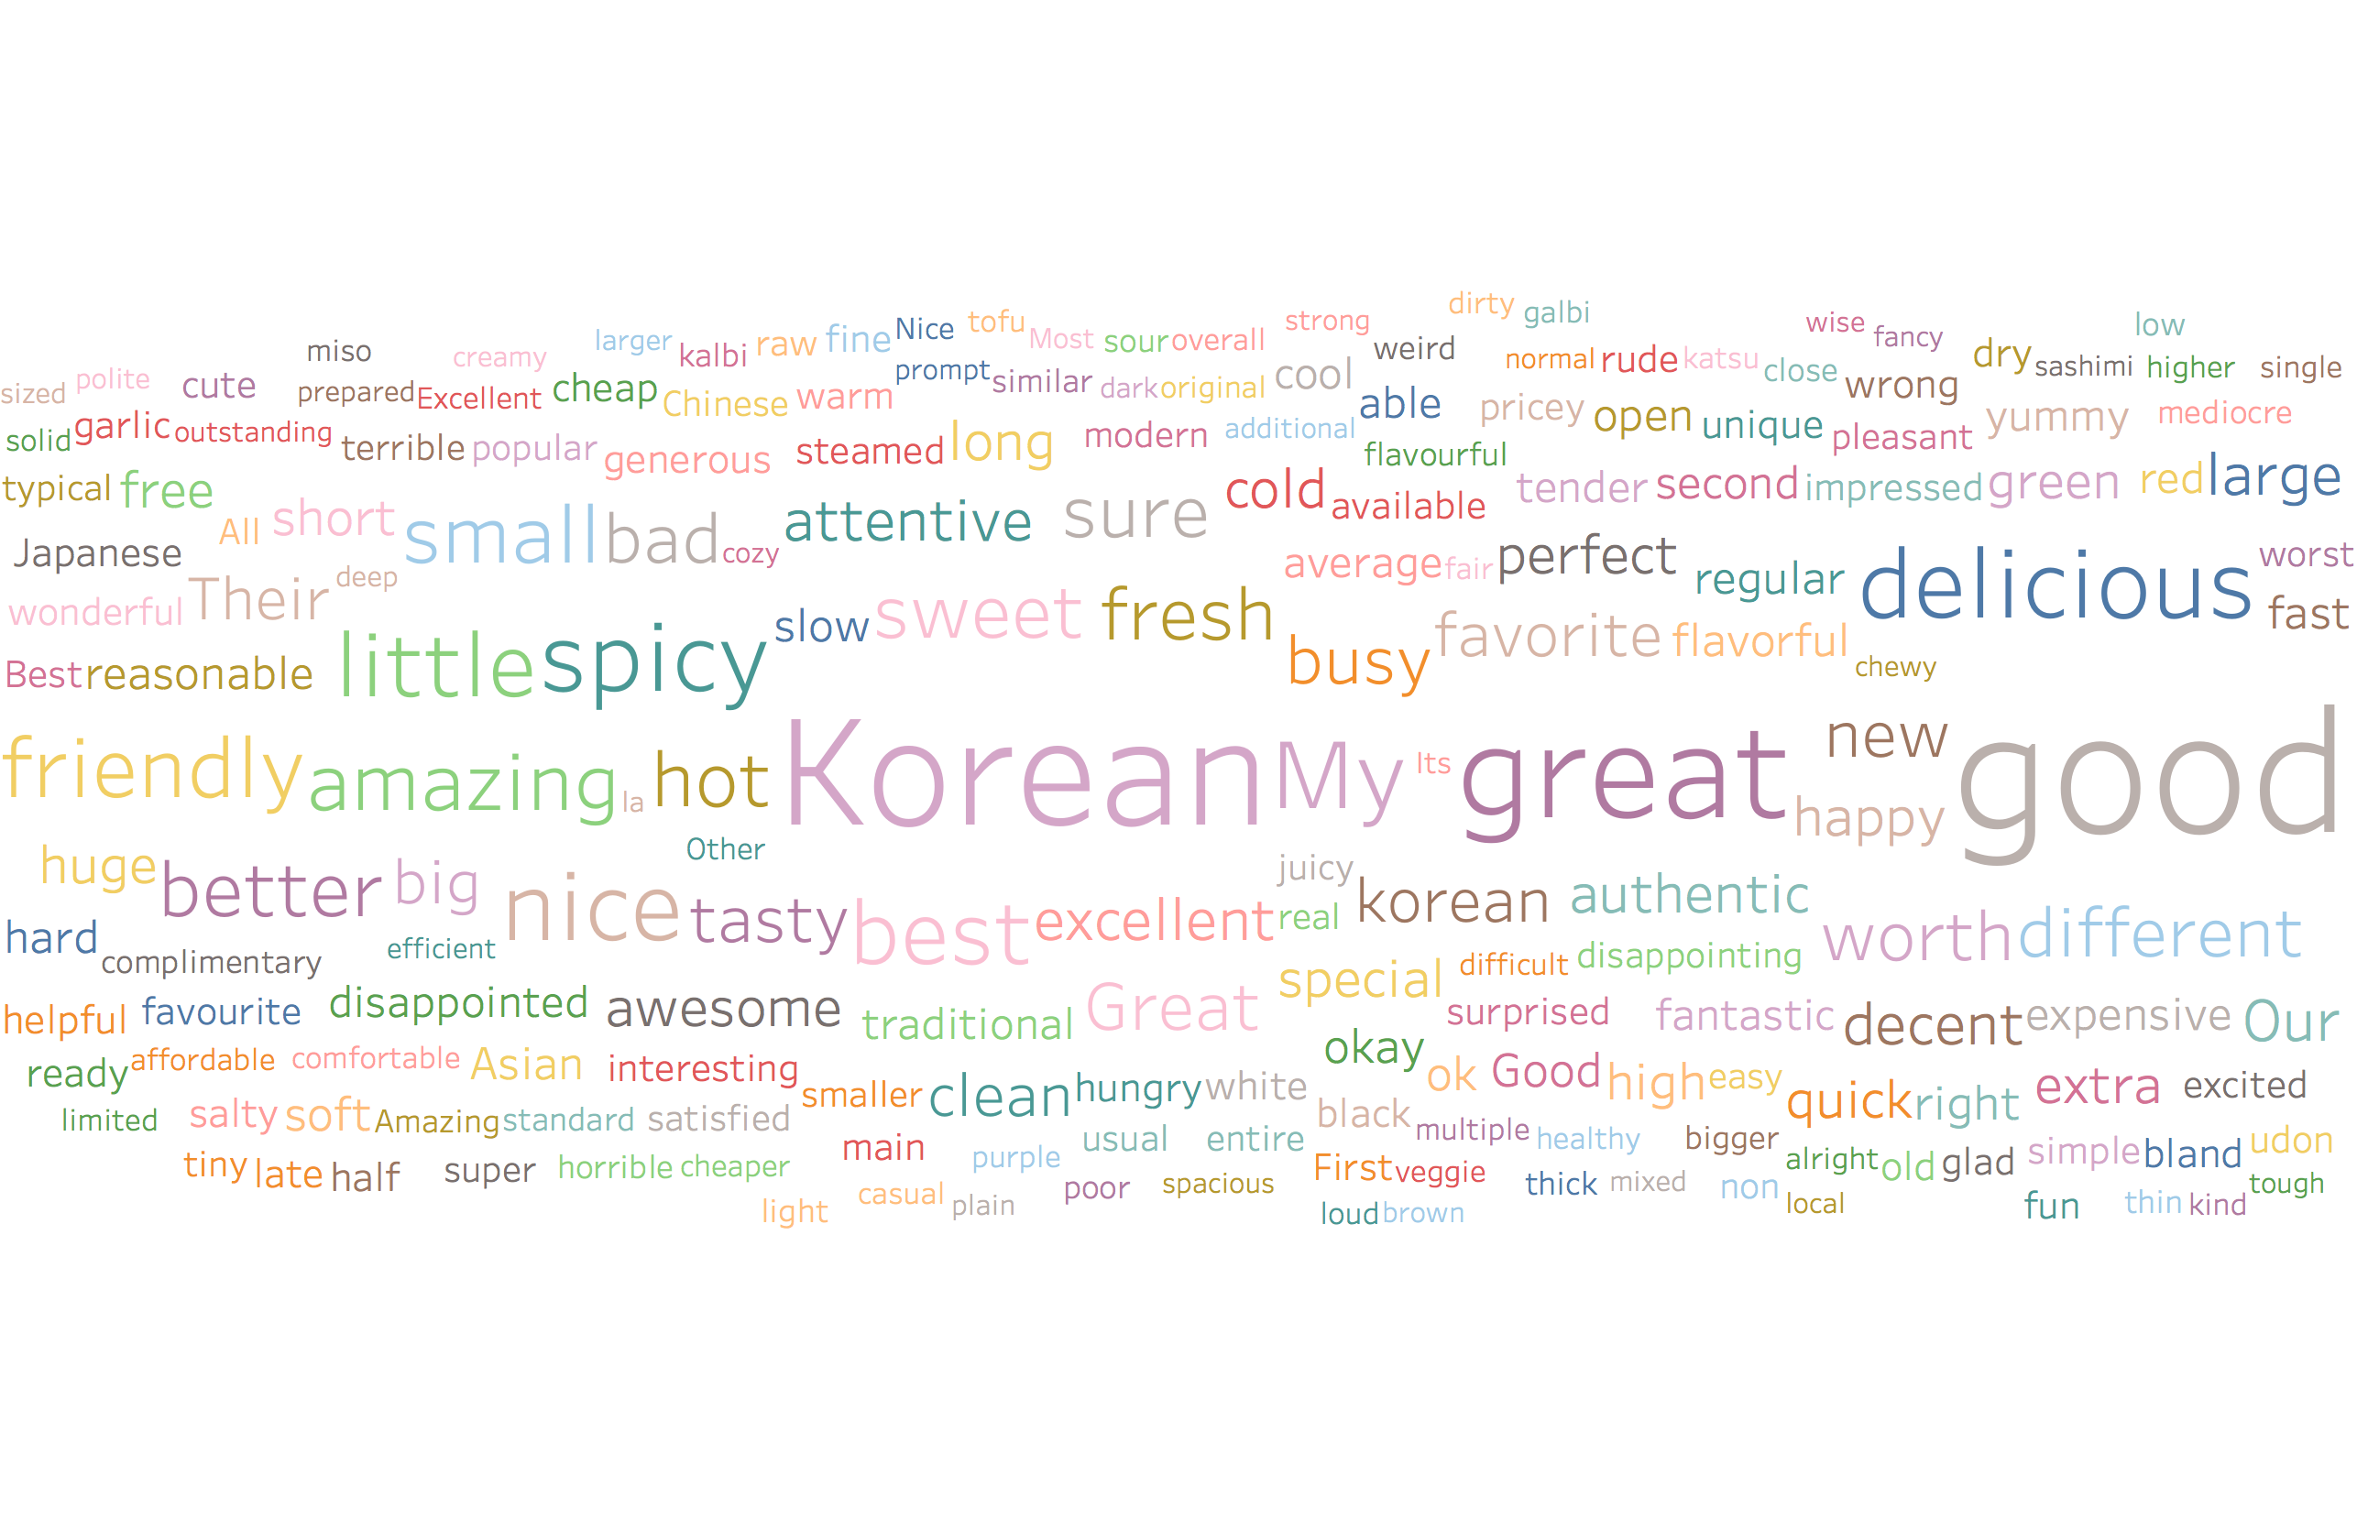
Word Cloud Korean

Slide 23
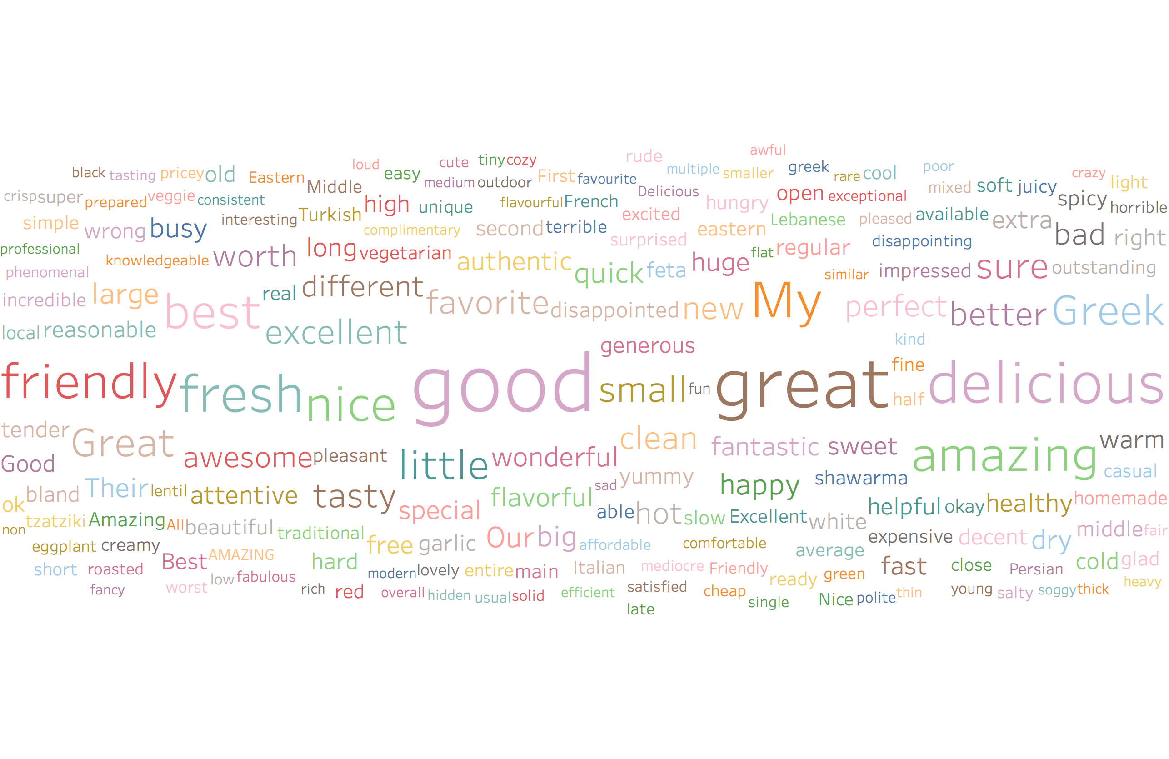
Word Cloud Mediterranean

Slide 24
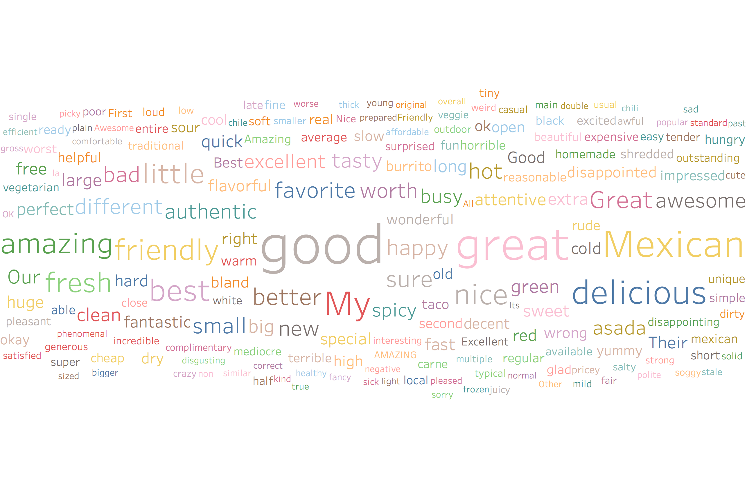
Word Cloud Mexican

Slide 25
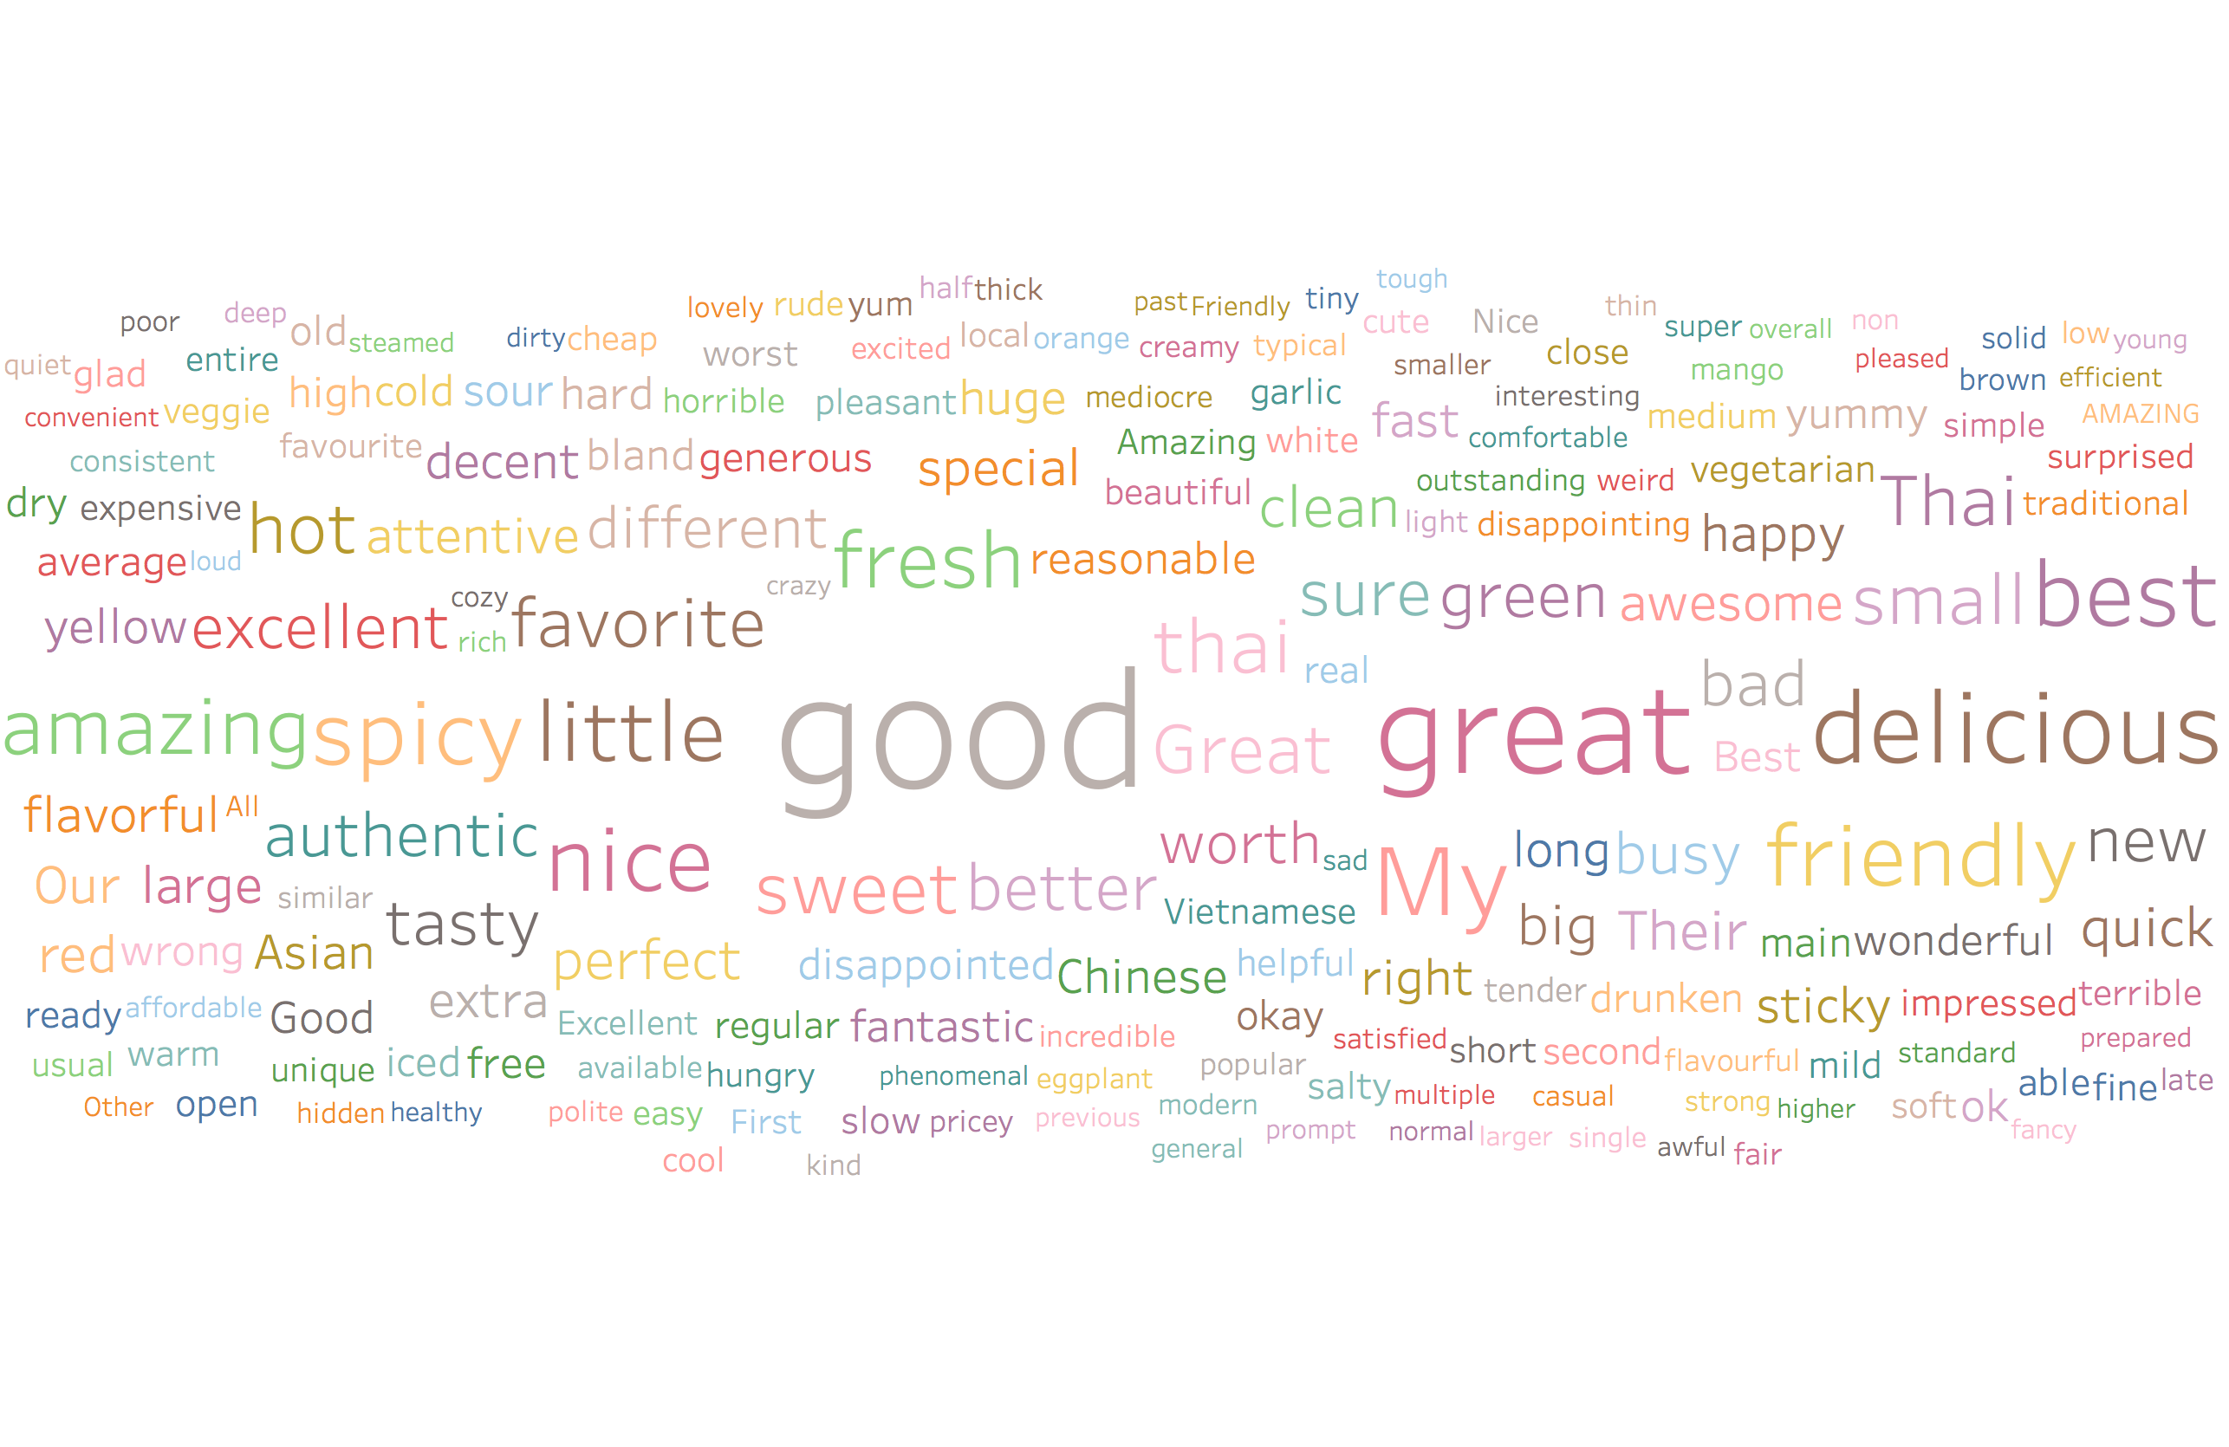
Word Cloud Thai

Slide 26
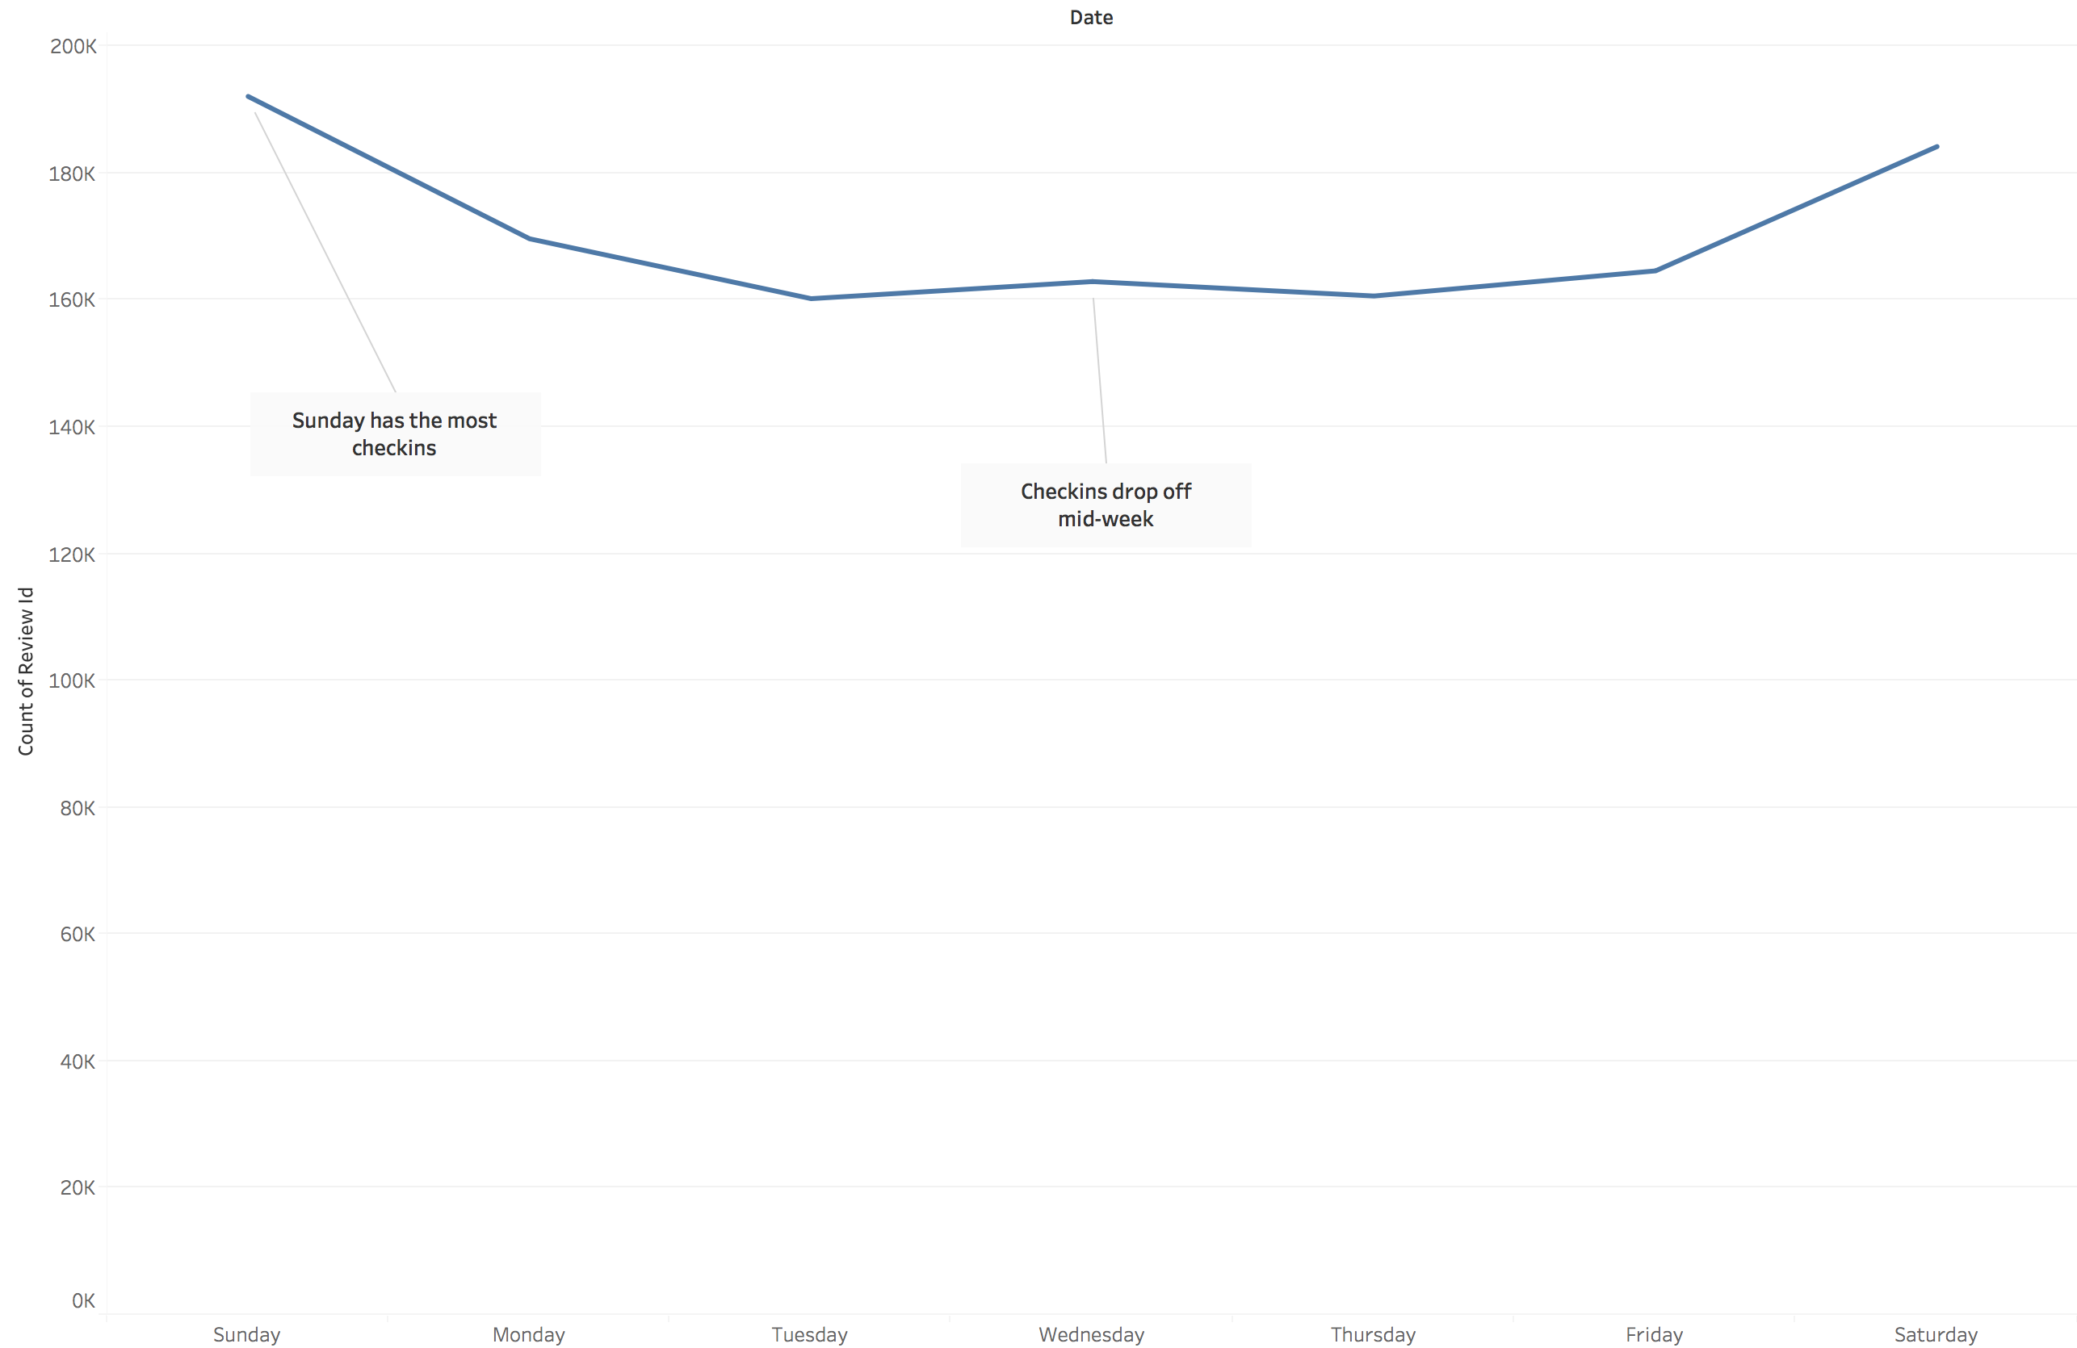
Temporal Trends Daily

Slide 27
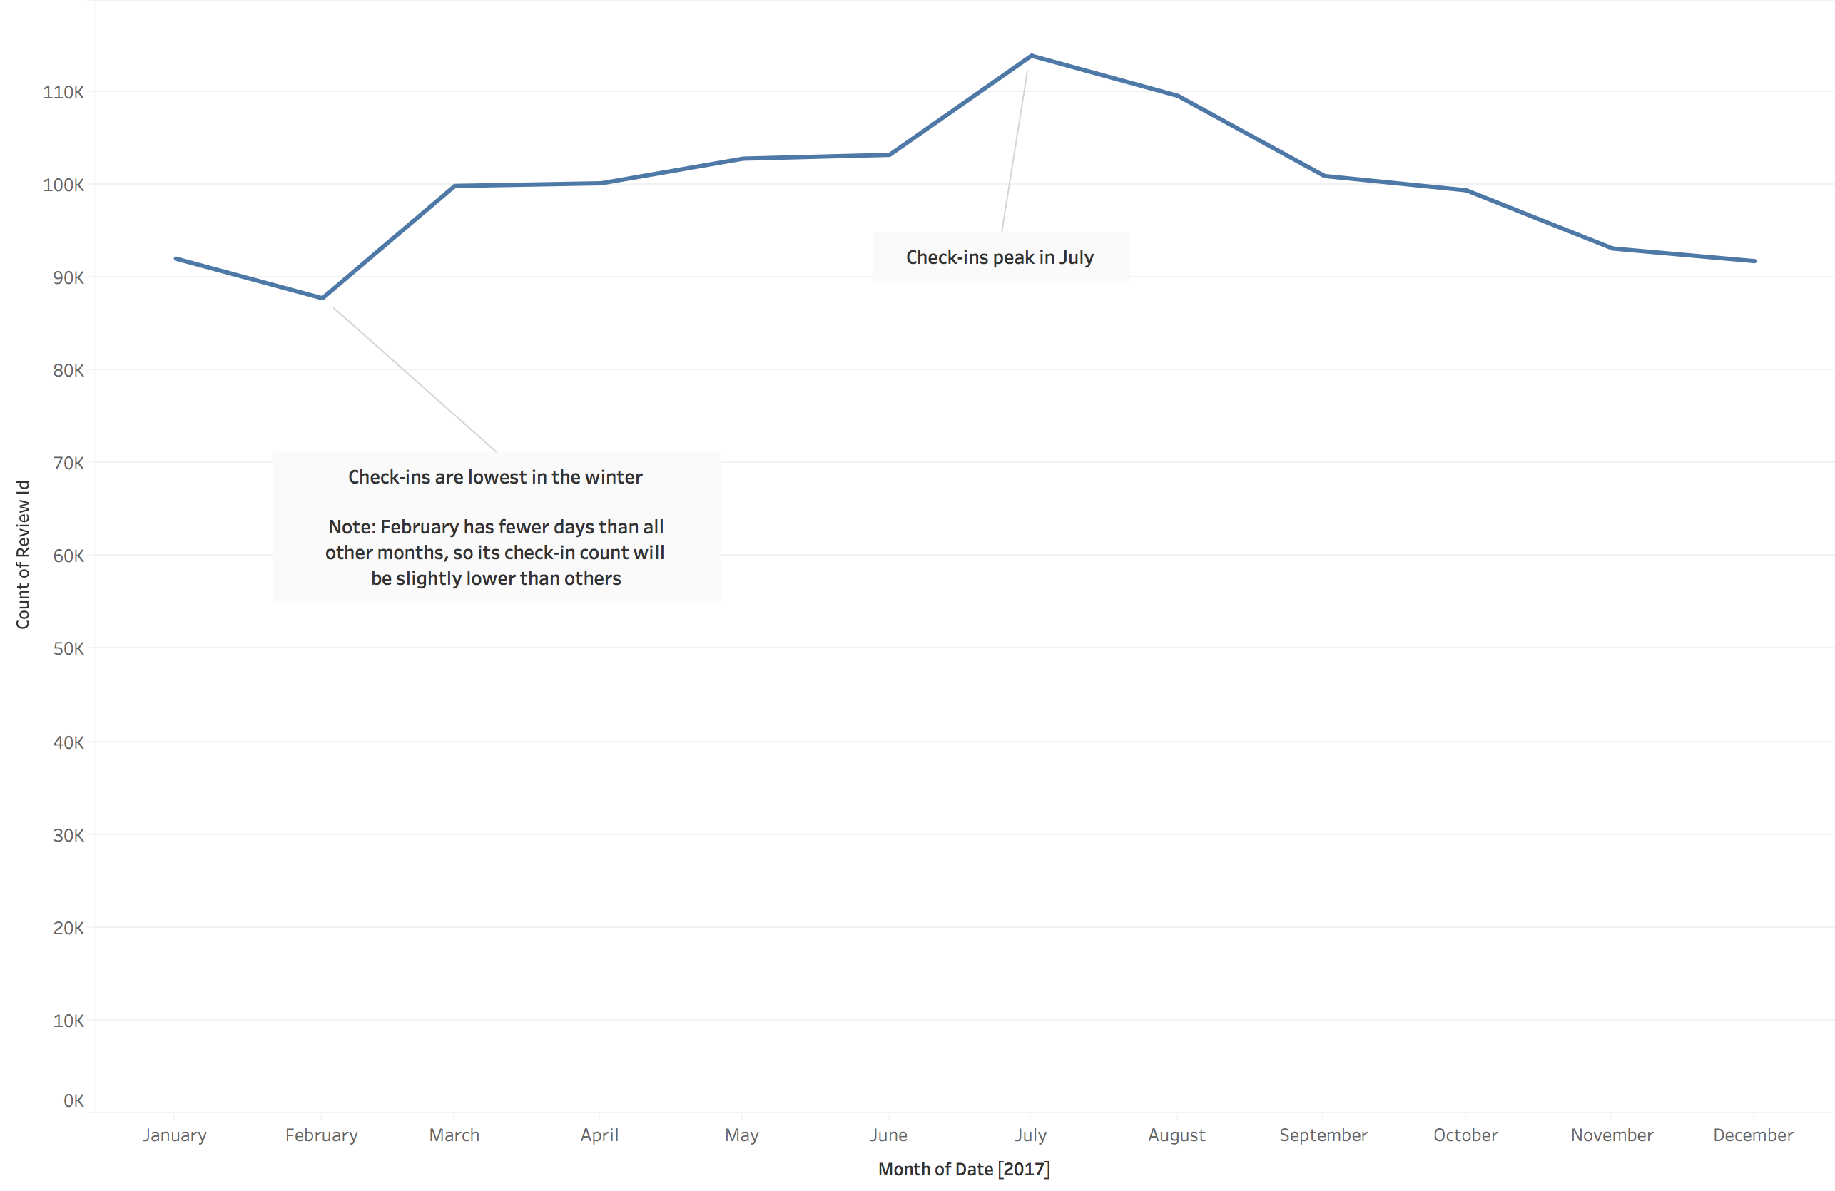
Temporal Trends Monthly

Slide 28
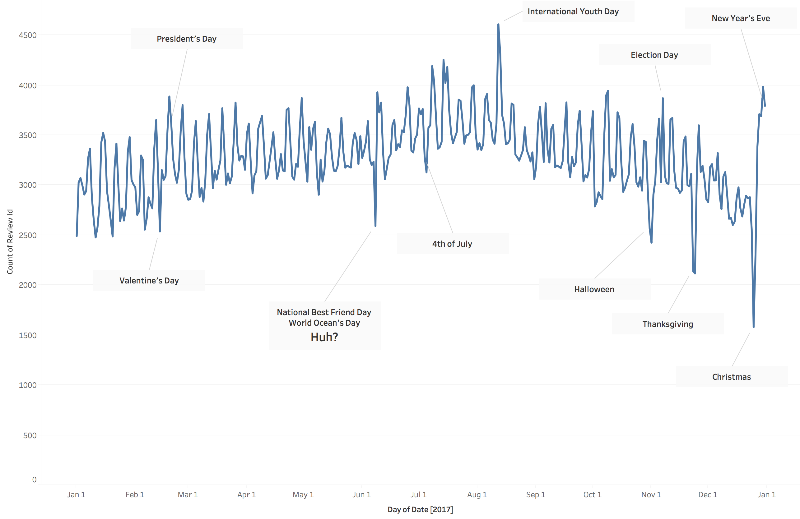
Temporal Trends Holidays
The data repeats the weekly trend of high check-ins on weekends and low throughout the week.
There is a negative spike on June 8th, 2017 which I cannot explain. It does not seem to coincide with any events I can find through searching. Likewise with a positive spike on August 12th.

Slide 29

Further Questions from the Mayor of Chicago

Slide 30
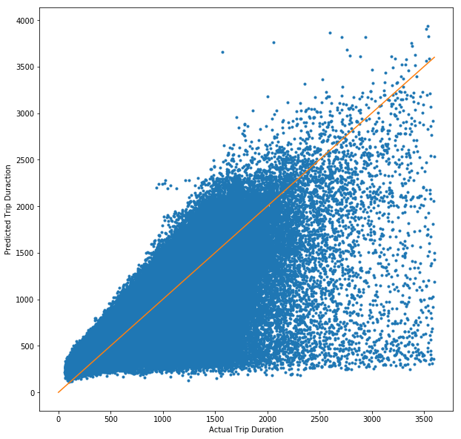
Predicted Travel Time
This shows predicted vs actual travel times for a given trip. In a perfect model, all points would lie along the orange line. Further discussion can be found in the Readme.

Slide 31
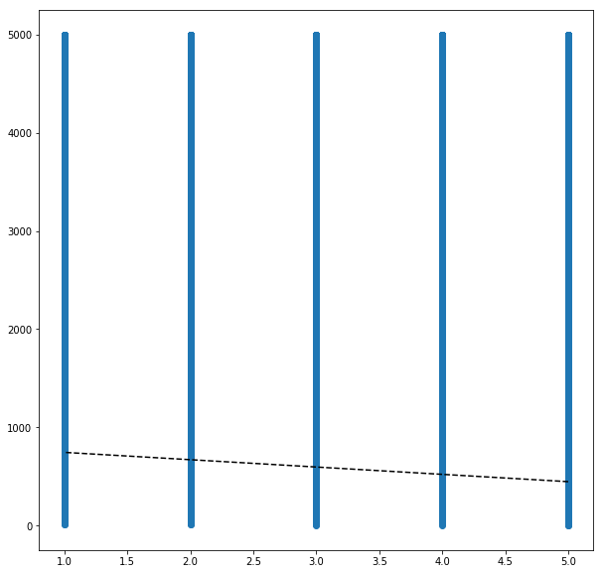
Star Rating vs Review Length
The data unfortunately shows no correlation between a review’s length and the corresponding star rating. The line to the right is nearly horizontal with a P-value of 0. Further discussion can be found in the Readme.

Slide 32
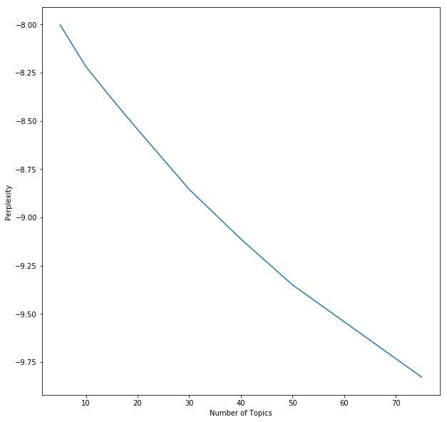
Topic Modelling
I would like to refine the perplexity chart to the right. There appears to be a slight elbow around 50 (which would indicate the ideal number of topics), but I would like to rerun the data with a much wider range of topics (say, 5 – 300). Processing time is a limiting factor on my laptop.

